Slide 1


VET course design for TECGREMED
Prof Diana Spulber, Fondazione Sicurezza e Liberta , Rome and
University of Genoa, DISFOR

Slide 2
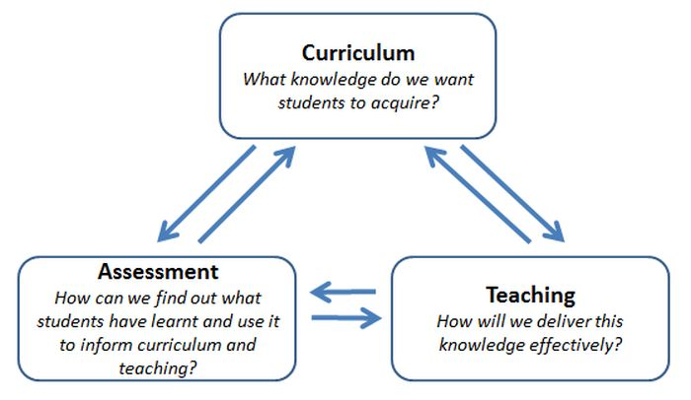
.
.

Slide 3
.
The philosophy of teaching as a way of life underscores the importance of personal relevance in the learning process, allowing educators to connect philosophical inquiry to students’ individual experiences.
In light of contemporary shifts towards integrated learning models, educators are called upon to adapt their pedagogical approaches to meet diverse student needs effectively

Slide 4
Curriculum development
Curriculum development is a systematic process involved in designing, implementing, and evaluating educational programs to enhance teaching and learning. It encompasses various elements, including the identification of educational goals, the selection of content, and the appropriate pedagogical strategies to achieve desired outcomes.
Effective curriculum development not only addresses the needs of learners but also aligns with broader educational standards and community expectations.

Slide 5


Cine sunt eu ?

Slide 6
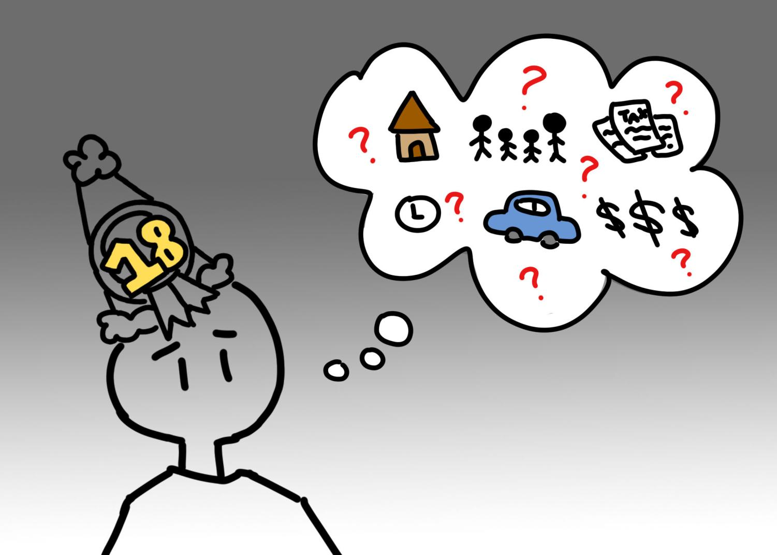
Who are the students

Slide 7
Teaching skills
The effectiveness of teaching skills is paramount in shaping student learning outcomes, particularly within the framework of curriculum development. Effective teaching not only conveys content knowledge but also fosters critical thinking and problem-solving abilities, which are essential for students’ future success.

Slide 8
…
The process of curriculum development is a dynamic and iterative endeavor that encompasses several critical phases, including needs assessment, design, implementation, and evaluation. Effective curriculum development requires collaboration among educators, stakeholders, and subject matter experts to ensure that educational programs meet the diverse needs of learners. The application of innovative teaching methodologies, such as critical thinking pedagogy and case-based learning, has been shown to enhance teacher competencies and student engagement significantly, leading to improved educational outcomes
Successful educators leverage their curriculum development expertise to foster enriched learning experiences, demonstrating the vital link between robust curriculum design and effective teaching skills.

Slide 9
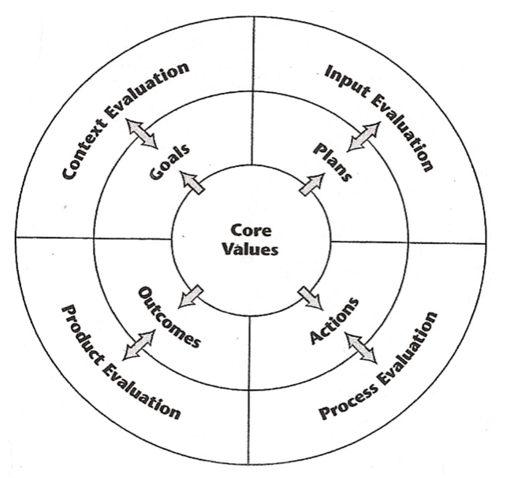
CIPP Model
Moreover, comprehensive professional development programs draw upon frameworks like the CIPP model—Context, Input, Process, and Product—to systematically evaluate curricular effectiveness and refine teaching practices (Wicaksono H et al.)

Slide 10
What are Learning Outcomes?
Learning outcomes are specific statements of what students will be able to do when they successfully complete a learning experience (whether it's a project, course or program). They are always written in a student-centered, measurable fashion that is concise, meaningful, and achievable.

Slide 11
The start??
Effective curriculum development begins with a clear understanding of the educational needs and goals of students, which is essential for promoting meaningful learning experiences. VET
This process involves comprehensive assessments that identify the specific skills, knowledge, and competencies that learners must acquire.
By adopting a person-centered approach, educators can tailor their curricula to better support individual student trajectories, as highlighted in the strategies suggested in
Identifying VET educational needs and goals serves as a critical foundation for the development of curricula that effectively prepares students for future challenges.

Slide 12
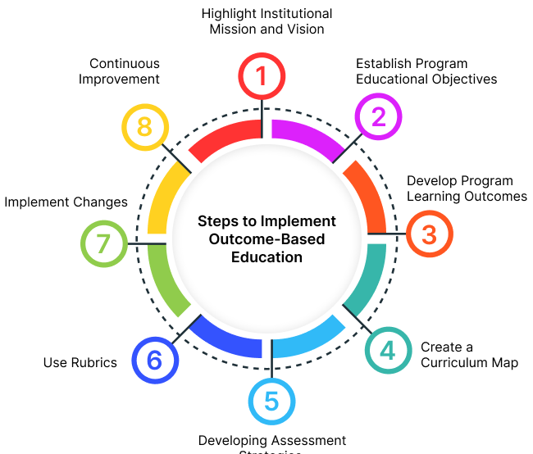
CD
An effective curriculum framework integrates diverse pedagogical strategies and aligns with educational standards to foster robust learning outcomes. As exemplified in recent reforms driven by the Outcomes-Based Education (OBE) framework, there is an imperative to shift from traditional teaching models towards competency-focused learning, facilitating deeper engagement in subjects such as engineering and social-emotional learning (SEL)

Slide 13
Skills
The professional competence of a teacher is not limited to a set of knowledge and skills, but establishes the need and effectiveness of their application in educational practice.
- communicative competence - emotional stability; extraversion; ability to build direct and feedback communication; speech skills; ability to listen and hear; ability to reward; delicacy, ability to make communication "smooth";
- information competence - the amount of information (knowledge) about yourself, about students and their parents, about the work experience of other teachers;
- regulatory competence - goal setting, planning, mobilization and sustainable activity, evaluation of performance, reflection;
- intellectual and pedagogical competence - a set of skills in analysis, synthesis, comparison, abstraction, generalization, concretization;
- operational competence - a set of skills necessary for a teacher to carry out professional activities: predictive, projective, subject-methodological, organizational, pedagogical improvisation, expert

Slide 14
Communication skills and their impact on learning
Effective communication skills are fundamental in fostering an enriching learning environment, significantly influencing students academic success and engagement levels. In classroom settings, clear and open communication facilitates a collaborative atmosphere where learners feel empowered to express their ideas and queries. This exchange not only enhances information retention but also encourages critical thinking and problem-solving skills, which are essential for holistic education

Slide 15
Classroom management techniques
Effective classroom management techniques are integral to fostering a conducive learning environment, which is essential for successful curriculum development and teaching skills. Strategies such as establishing clear rules, implementing consistent consequences, and creating engaging lesson plans can significantly enhance student behavior and participation.

Slide 16
Differentiation strategies to meet diverse learner needs
Differentiation strategies are essential for effectively addressing the diverse needs of learners within the framework of curriculum development and teaching skills.
By tailoring instructional methods and materials to accommodate varied learning styles, educators can foster a more inclusive classroom environment.
Using formative assessments allows teachers to gauge individual student needs, thus enabling targeted interventions that enhance learning outcomes.
Drawing on teachers’ beliefs and values, as highlighted in inclusive education discourse, reveals how these factors influence the implementation of differentiation strategies in practice

Slide 17
…
Learning outcomes are statements referring to the specific knowledge, practical skills, areas of professional development, attitudes, or higher-order thinking skills that instructors expect students to develop, learn, or master by the end of their learning (Suskie, 2009)

Slide 18
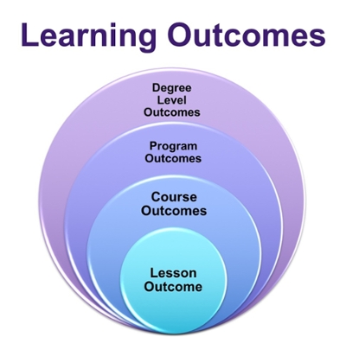
…
Outcomes are used on many scales, from developing curriculum for a program of study to creating lessons for a single class activity. At the highest level, learning outcomes can be established at the university level.

Slide 19
Learning outcomes
Just as learning outcomes can be designed at the program level or university-wide level, they can also operate at a more granular scale within an individual course. Typically instructors divide their courses into smaller units such as modules or weeks, and many instructors establish learning outcomes for these smaller units that map onto the larger course-level outcomes. As a general rule, as the level of analysis becomes smaller, from course to module to assignment, the learning outcomes tend to be more specific and easily quantifiable.

Slide 20
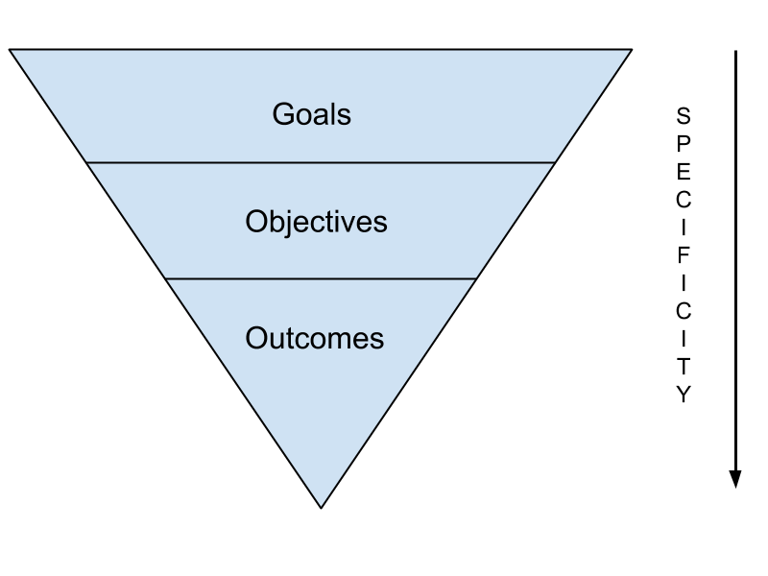
..

Slide 21
…
Identifying the desired results of a learning experience is the first step of backward design.
Learning outcomes are used for this purpose. Learning outcomes are also valuable in these ways:
Learning outcomes help instructors...
describe to students what is expected of them
plan appropriate teaching strategies, materials and assessments
learn from and make changes to curriculum to improve student learning
assess how the outcomes of a single course align with larger outcomes for an entire program
Learning outcomes help students…
anticipate what they will gain from an educational experience
track their progress and know where they stand
know in advance how they'll be assessed

Slide 22
..
NOT Student-Centered Different theories of personality development will be explored through lectures, readings, and assignments. | Student-Centered Students will name each theory of personality development and describe the key characteristics that distinguish each theory.
Not Measurable Students will understand symbolism. | Measurable Students will be able to identify examples of symbolism in short stories and incorporate symbolism in their own writing.
Not Clear Students will be able to analyze MZ History . | Clear Students will be able to analyze how MZ foreign policy history relates to current trends in MZ. foreign policy.
Not Concise Students will analyze MZ intern policy, from 20th-century diplomatic relations with Europe to considering the ways in which shifts from past to MZ independency. | Concise Students will be able to identify how changes in MZ foreign policy during the 20th and 21th centuries impacted relations with neighboring nations.
Task-Based (Inflexible) Students will be able to demonstrate on a mannequin the four steps to administer CPR. | Outcome-Based (Flexible) Students will be able to demonstrate the four steps used to administer CPR.

Slide 23
Quick Guide to Four Instructional Design Models
ADDIE Model.
Merrill's Principles of Instruction.
Gagne's Nine Events of Instructions.
Bloom's Taxonomy.

Slide 24
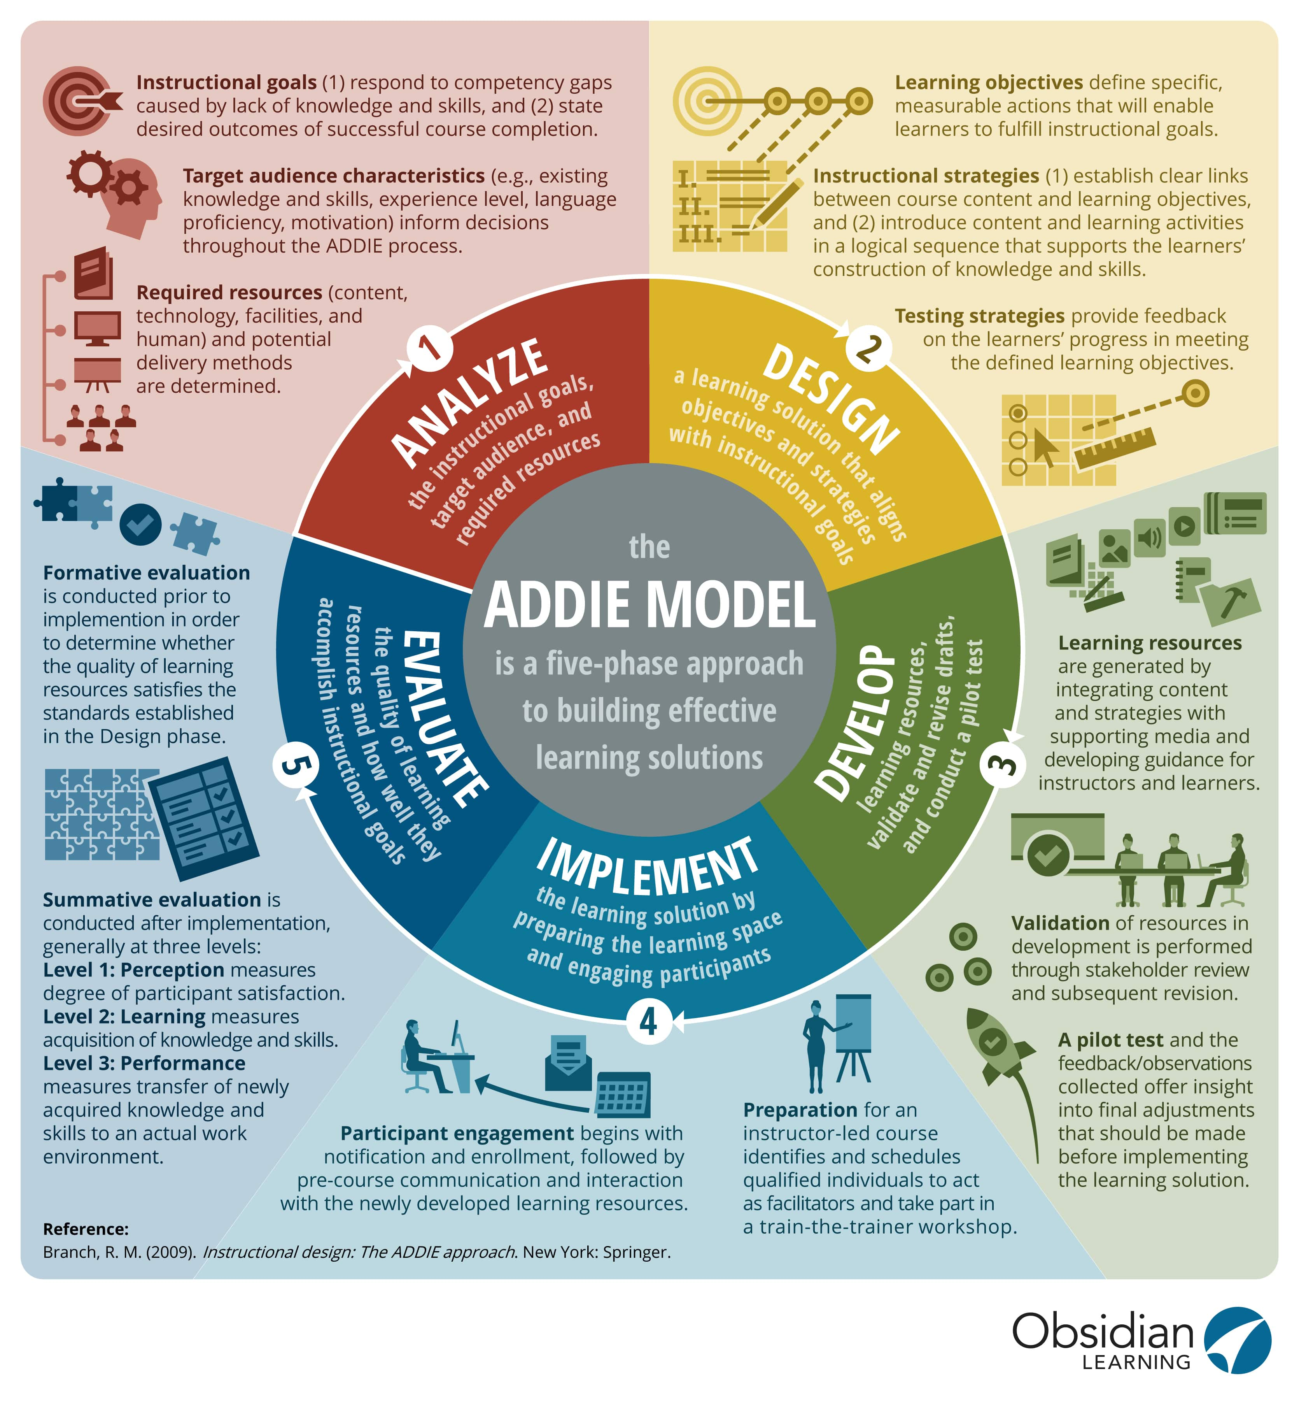
…

Slide 25
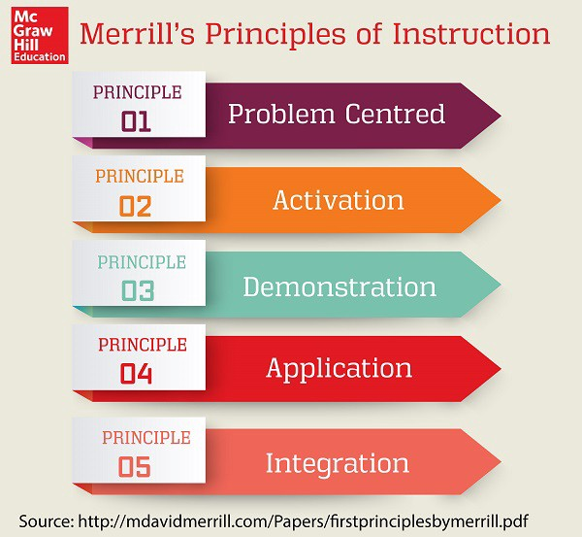
…

Slide 26
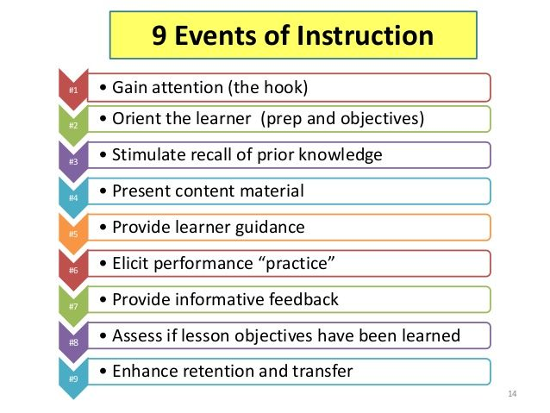
…

Slide 27
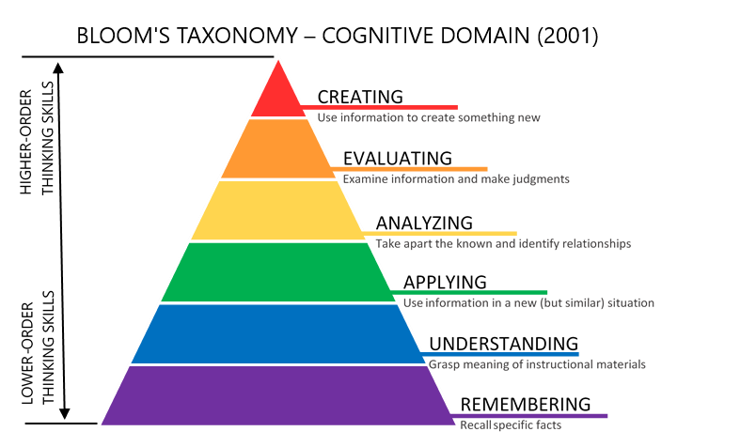
…

Slide 28
Learning Design

Slide 29
The Requirements of a Learning Design Specification
1. Completeness: the specification must be able to fully describe the teaching/learning process in a UOL, including references to digital and non-digital learning materials, digital and non-digital, and the services needed during the process.
This includes:
- The integration of learner and teaching staff activities.
- The integration of resources (objects and services) used during learning.
- The support of learning models for both single and multiple users.
- Support for blended learning and fully online learning.
online learning.

Slide 30
…
2. Pedagogical expressiveness:
The specification must be able to express the pedagogical meaning and the functions of the different elements within the context of an LD. While it must be flexible enough to describe LODs based on all types of pedagogical approaches, it must avoid skewing towards any particular pedagogical approach.

Slide 31
…
3. Personalisation: The specification must be able to describe aspects of personalisation within a LOD, so that the contents and activities within a UOL can be adapted on the basis of preferences, portfolios, pre-existing knowledge educational needs and the situations in which users find themselves. It must also allow the designer, if desired, to pass control over the process of adaptation to the learner, a staff member and/or the computer.
4. Compatibility: The specification must allow for the effective use and integration, when possible, other available standards and specifications, such as the IMS specification imsglobal.org) and the IEEE LTSC (ltsc.ieee.org) (see Olivier & Liber, 2003).

Slide 32
…
Since an LD specification should extend and complement existing specifications, it must also inherit most of the more general requirements for specifications and standards for interoperability:
5. Reusability: The specification must make it possible to identify, isolate, de-contextualisation, exchange of useful learning objects and their reuse in other contexts.
6. Formalisation: The specification must provide a formal language that can be processed automatically.
7. Reproducibility: The specification must allow for the abstraction of a Learning Design in repeated execution in different situations and with different people.

Slide 33
Control /Assesment
- The role of assessment in the educational process is determined by J. Biggs' rule: "Students learn not what is in the syllabus, but what they think will be assessed".
- Peculiarities of competence assessment: assessment in a professional context; integrative nature of assessment; binary assessment ("pass-fail"). The optimal means of evaluating competencies based on the results of the PM and the educational programme as a whole is the demonstration examination.
- In order to ensure all the main types of assessment of students within the educational programme (interim, midterm, final), a fund of assessment tools (FES) should be developed. The structure of the FS includes both typical tasks and (if necessary) "reference answers".

Slide 34
…
Evaluation is a key element of any activity, as it allows managing results, identifying deviations from the norm and making decisions aimed at eliminating the causes that did not allow to achieve the desired. Evaluation is based on comparing the current state of an object (process, phenomenon, system) with a benchmark.
Evaluation in the educational process is the collection and analysis of information on what knowledge, skills and competences students have.

Slide 35
…
The aims of assessment usually come down to two types:
- 1) assessment needed to make decisions about support for specific learners;
- 2) assessment used to shape management decisions at different levels of the education system, from the individual educational organisation to the national ministry of education.

Slide 36
Quality assurance
The quality assurance cycle assures the integrity of the assessment and reporting of student achievement against the performance standards for a subject. The interpretation and application of the performance standards is confirmed by a moderation process as part of the quality assurance cycle, ensuring students have fair, valid, and reliable results.
There are four stages in the quality assurance cycle: planning, clarifying, confirming, and improving.

Slide 37
Planning
In the planning stage of the quality assurance cycle, teaching, learning, and assessment opportunities are devised to enable students to demonstrate their learning against all aspects and levels of the performance standards.
During planning, teachers are responsible for:
preparing a teaching and learning program
developing a learning and assessment plan (LAP)

Slide 38
clarifying,
In the clarifying stage of the quality assurance cycle, teachers develop and maintain an understanding of the performance standards and how to apply them consistently to student work.
Teachers develop this understanding by:
working collaboratively with other teachers
participating in professional learning
Teachers apply this understanding to task design and the assessment of student work.
See Professional learning for information about clarifying activities for teachers.

Slide 39
Confirming
In the confirming stage of the quality assurance cycle the performance standards in each subject are applied consistently across schools to report student achievement.
During confirming, teachers are responsible for:
assessing student evidence and provide a result in the range A to E for Stage 1 subjects and A+ to E– for Stage 2 subjects, at the end of the teaching and learning program, based on the performance standards for each subject
applying results consistently in all classes for each subject throughout the school
ensuring that their interpretation and application of the performance standards in a subject are consistent with those of other teachers
implementing the school’s supervision and verification procedures to ensure the authenticity of student materials submitted for assessment
using Schools Online to complete results sheets and submit these to their principal or their principal’s delegate, for verification and submission to the QAS Board.

Slide 40
Improving
In the improving stage of the quality assurance cycle, processes are monitored and analysed so that strategies for improvement can be developed.
During improving, teachers are responsible for:
acting on feedback from the QAS Board
analysing and using the results of their students’ learning to guide and strengthen their understanding and application of the performance standards, and improve their assessment design and teaching.

Slide 41
Assesment of learnng outcomes
Conducting regular assessment helps an academic program determine how the curriculum is contributing to the learning and development of students. Assessment helps programs:
Discover through empirical evidence "what students are learning"
Identify gaps in student learning areas
Inform teaching pedagogy by aligning best practices with learners’ needs
Make informed decisions; guide curriculum, course action, and revision
Demonstrate overall program effectiveness; showcase student learning ‐ "what works"

Slide 42
Referencies
https://www.worldbank.org/en/topic/education/publication/step-by-step-sel-curricula
Bloom, B. S., Engelhart, M. D., Furst, E. J., Hill, E. J., & Krathwohl, D. R. (Eds.). (1956). Taxonomy of educational objectives: The classification of educational goals. New York, NY: Longmans, Green and Co.

