Slide 1

TECGREMED - TEChnical GREen Engineering skills for MEDiterranean Region
“GREEN”
European Union Environment public policy: towards a «resource-efficient economy» by Prof Dr. Alessandro Figus
WP2 – TRAINING, FEZ MOROCCO October 2025

Slide 2
Protection of the environment, an European policy
The European Union's environmental policy shall contribute to the following objectives:
safeguarding, protecting and improving the quality of the environment,
protecting human health,
prudent and rational use of natural resources,
promoting measures at international level to solve regional or global environmental problems and, in particular, to combat climate change.
2. [ ... ] It is based on the principles of precaution and preventive action, on the principle of priority correction at source of damage caused to the environment, and on the «polluter pays» principle

Slide 3
Environment Action Programme
It is focuses on 4 priority areas :
climate change
nature and biodiversity
environment, health and quality of life
natural resources and waste
and on 2 horizontal areas:
international cooperation
strategic policy approaches (better implementation, cooperation with the market)

Slide 4
European Action Programme
The 8th EAP entered into force on 2 May 2022, as the EU’s legally agreed common agenda for environment policy until 2030.
The action programme reiterates the EU’s long-term vision to 2050 of living well and within planetary boundaries. It sets out priority objectives for 2030 and the conditions needed to achieve these. Building on the European Green Deal, the action programme aims to speed up the transition to a climate-neutral, resource-efficient economy, recognising that human wellbeing and prosperity depend on healthy ecosystems.

Slide 5
8th EAP calls
The 8th EAP calls for active engagement of all stakeholders at all levels of governance, to ensure that EU climate and environment laws are effectively implemented. It forms the EU’s basis for achieving the United Nation’s 2030 Agenda and its Sustainable Development Goals.

Slide 6
The program developed in previous years
Since the 2010’s years the environmental legislation has been consolidated and completed covering all sectors with the exception of soil.
The previous programmes have provided a general framework for environmental policy, although some gaps and limitations are evident.
Continuation in pursuing an ambitious environmental policy as an integral part of the Europe 2020-2030 strategy.
The EU Commission will assess how a new environmental action programme can make an effective contribution in a rapidly changing environment.

Slide 7
Environment and economy
We have Harmonized environmental standards at European level condition for efficient and fair competition internal market (=> no eco-protectionism or eco-dumping)
Transport: environmental costs of transport and traffic are estimated 5% of EU GDP
Health: health costs related to air pollution in Europe are estimated between 50 and 100 billion/year. This includes around the social costs of 350,000 premature deaths / year and the loss of 150 million working days/year.

Slide 8
Cost of inaction: “The benefits of strong and timely action far outweigh the economic costs of inaction” (Stern Report, 2023):
• Action => 1% of global GDP per year until 2050 • Inaction => up to 20% of global GDP per year • Multi-annual project TEEB – The Economics of Ecosystems and Biodiversity (EC+G8+UNEP): analyzed the economic value of ecosystems and biodiversity: the benefits of investing in ecosystem protection exceed the costs by a factor of between 3 and 75.
• “In recent years, financial crises have periodically recurred, costing Wall Street around $1,000-$1,500 billion each time they have occurred. In fact, every year we lose natural capital worth between $2-$5,000 billion."

Slide 9
Competition for natural resources
Global population and living standards expanding on an unprecedented scale (9 billion in 2050):
2 billion people with 'middle class' consumption levels in today's developing countries will triple their consumption by 2020.
Demand for food, feed and fibre could increase by 70% by 2050, global demand for energy and water by 40% as early as 2030. 2050: 9 billion 2011: 7 billion

Slide 10
Global demand for resources is increasing rapidly => increasing shortage of raw materials + depletion of resources and environmental ecosystems that provide many raw materials.
• In the EU we use 16 t. of materials per capita/year.
• More than 20% of the resources used in Europe are imported, especially fuels, raw materials and agricultural products. Furthermore, imported products ‘contain’ a use of resources between 3 and 6 times greater than their simple material components.
• Competition for resources will increase, many countries are already equipping themselves (China, Gulf countries) by securing access to future scarce resources with exclusive contracts, especially in Africa (“land grabbing”): mines and mineral stocks, forests, fuels and large agricultural lands.
• Climate change will further increase the pressure on resources in some regions of the world and also in Europe (e.g. drought in the Mediterranean).

Slide 11
Resource efficiency
The EU wants to improve resource efficiency and achieve ‘absolute decoupling of resource use’ (the economy grows but resource use or environmental impact decreases in absolute terms)
• Reduce the impact of resource use on other resources, paying more attention to their interactions
• Manage renewable resources (including ecosystems) to maximise the services they provide us, while staying within the viable limits of ecosystems.
• Stimulate greater innovation in the economy, to ensure the structural changes needed to compete successfully in a changing world………

Slide 12
Sustainable Production and Consumption
Materials in the Life Cycle of a Product Impacts on resource base water, air, soil, land, biodiversity Material resourcesenergy carriers minerals metals biomass extraction
Production added to stocks Reuse, Recycling, Recovery reusedor recycled Waste disposal Consumption waste Impacts on resource base water, air, soil, land, biodiversity

Slide 13
Transforming the economy
Incentivising efficient production (SUPPLY)
• Stricter requirements for Green Public Procurement (GPP) and EU-funded projects linked to GPP? • Common methodological approach to assess and compare the environmental performance of products, services and companies on their life cycle environmental impact (“ecological footprint”)
• Extending the scope of the Ecodesign Directive to non-energy related products • Informing consumers on the ecological footprint of products (fight against misleading claims, clearer eco-labelling)
• Incentives for truly environmentally friendly products • Extending producer responsibility to the whole life cycle of products (advice on take-back and recycling schemes, support for repair services, etc.)
• Actions to optimise resource use at packaging level • Best possible use of their waste and by-products (industrial symbiosis) • Improving products and changing consumption patterns (DEMAND)

Slide 14
Transforming the economy
• Turning waste into a resource Every year in the European Union we throw away 2.7 billion tonnes of waste, of which 98 million tonnes are hazardous waste. On average only 40% of solid waste is reused or recycled, the rest ends up in landfill or incinerated.
• Stimulate the market for secondary materials and demand for recycled materials. • Binding targets on prevention, reuse, recycling?
• Minimum quotas for recycled materials, durability and reusability criteria?
• Eliminate illegal shipments of waste, in particular hazardous waste.
• Ensure that EU public funding (structural funds) prioritises activities at the highest levels of the waste hierarchy (e.g. recycling facilities over waste disposal).

Slide 15
Prevention
Reuse Recycling Recovery Disposal Priorities in waste management
Moving up the waste hierarchy: 1.prioritize prevention, 2. reuse and 3. recycling.

Slide 16
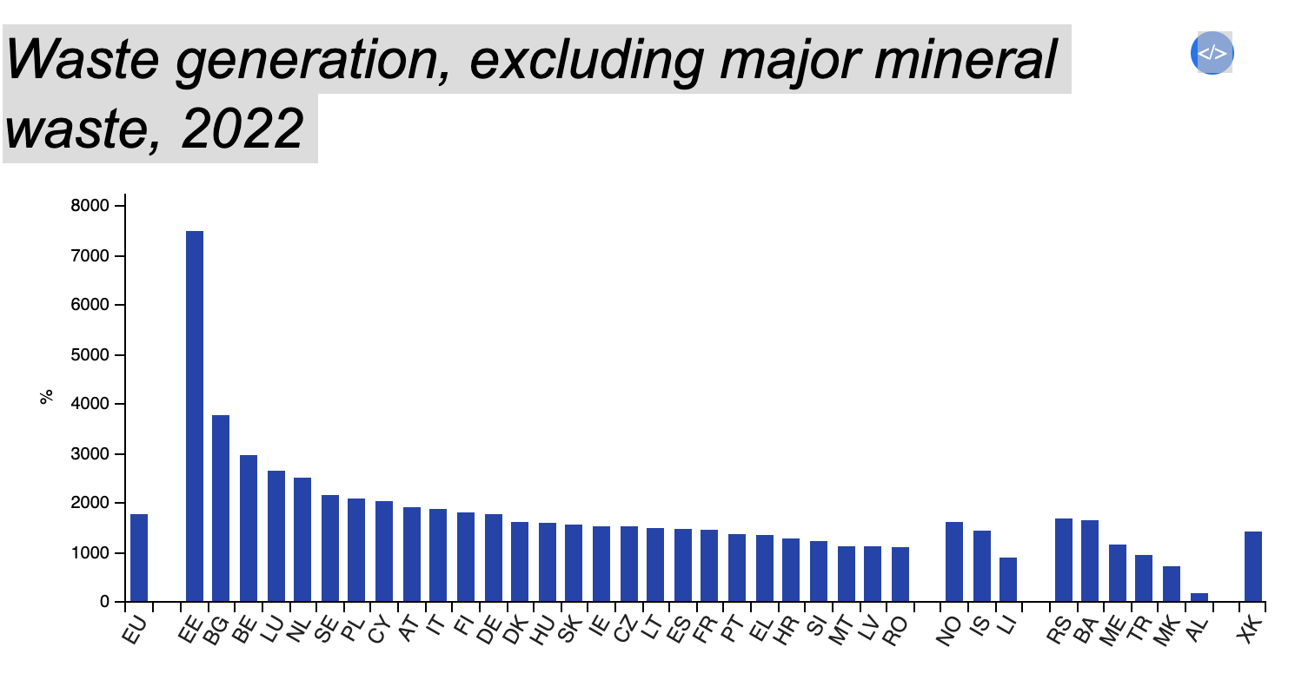
Highlights
In 2022, 5.0 tonnes of waste were generated per EU inhabitant.
In 2022, 40.8% of waste were recycled and 30.2% landfilled in the EU.

Slide 17
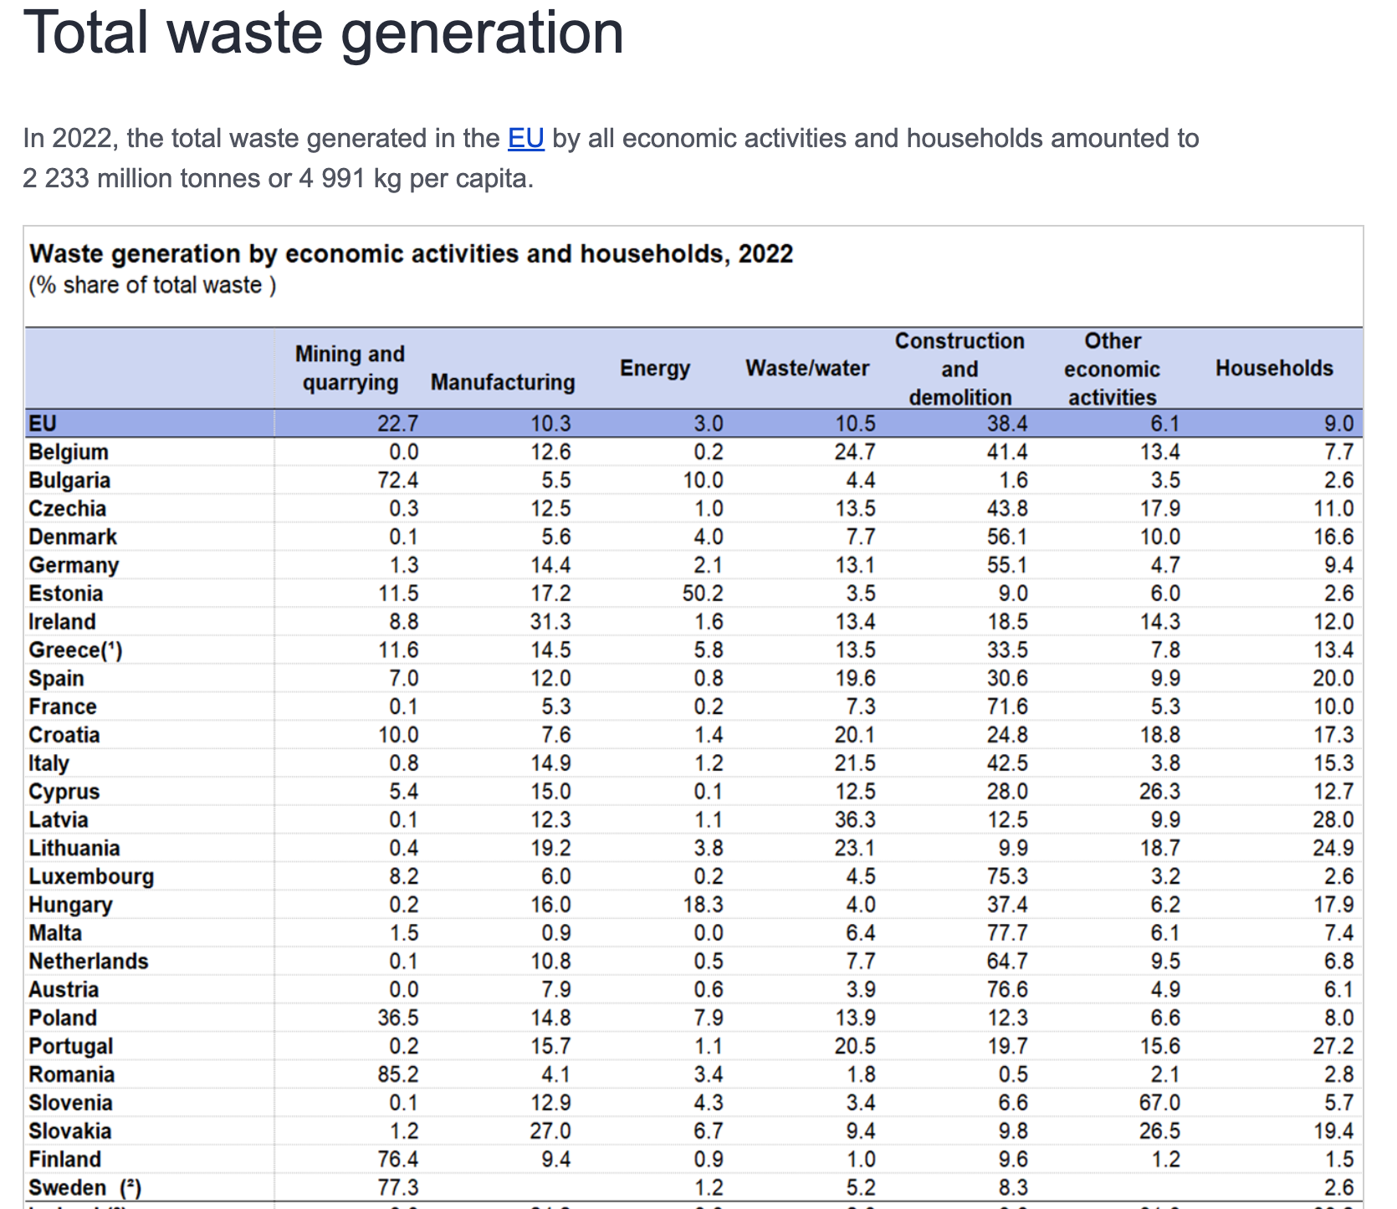

Slide 18
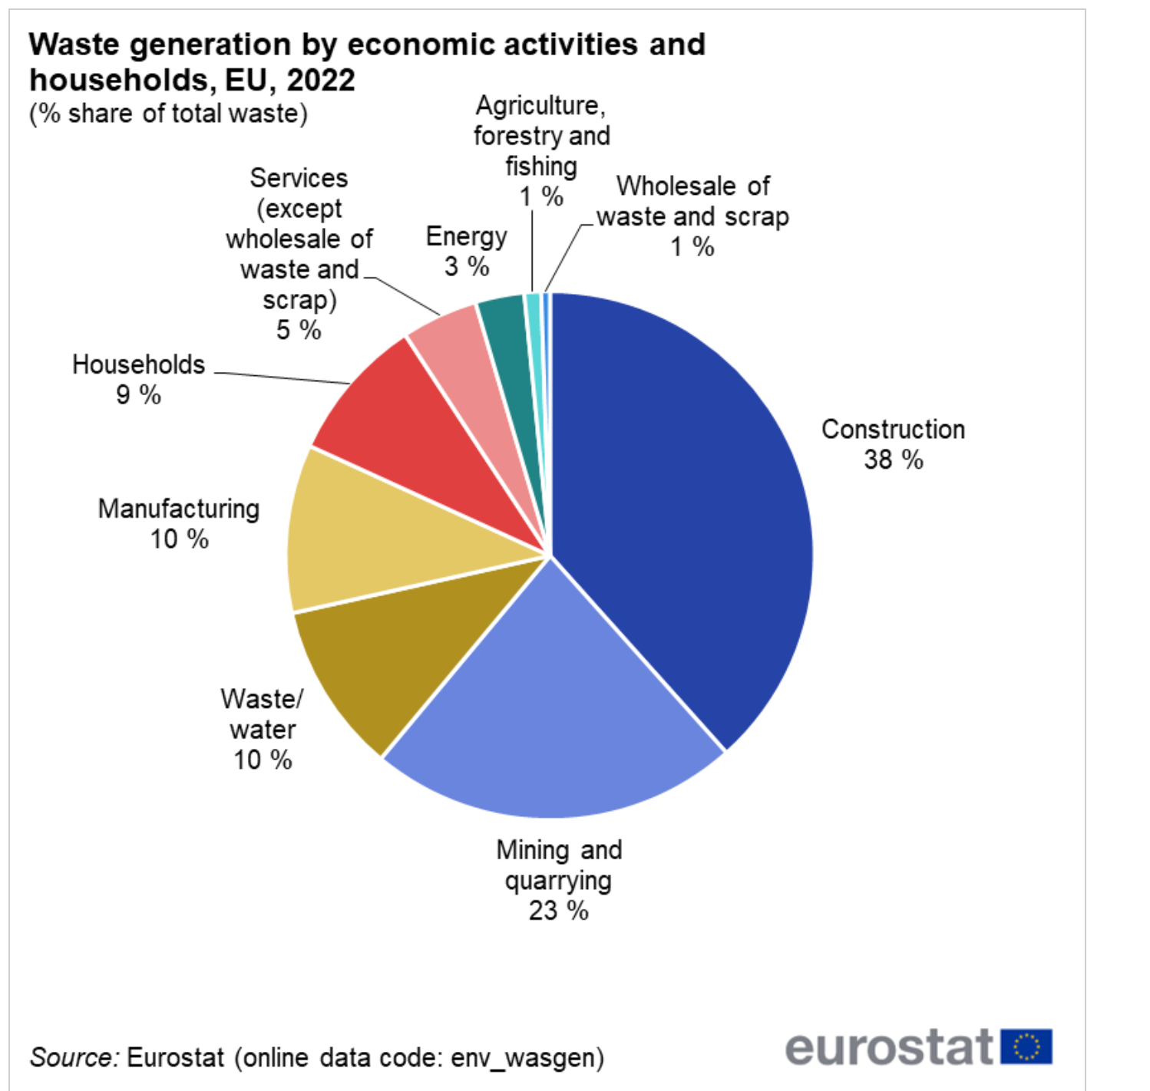

Slide 19
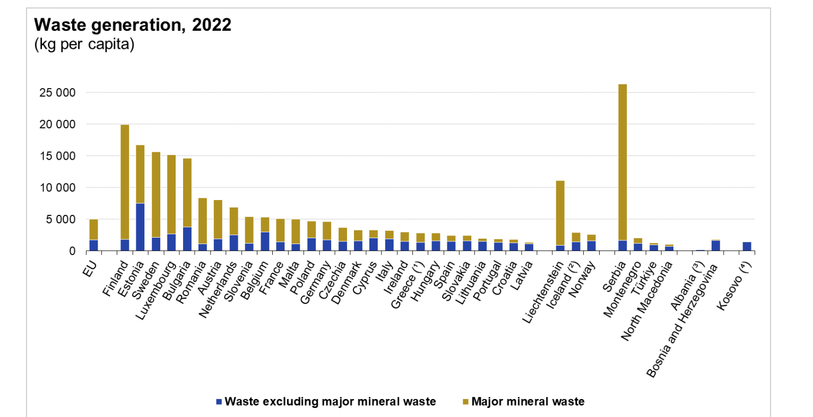

Slide 20
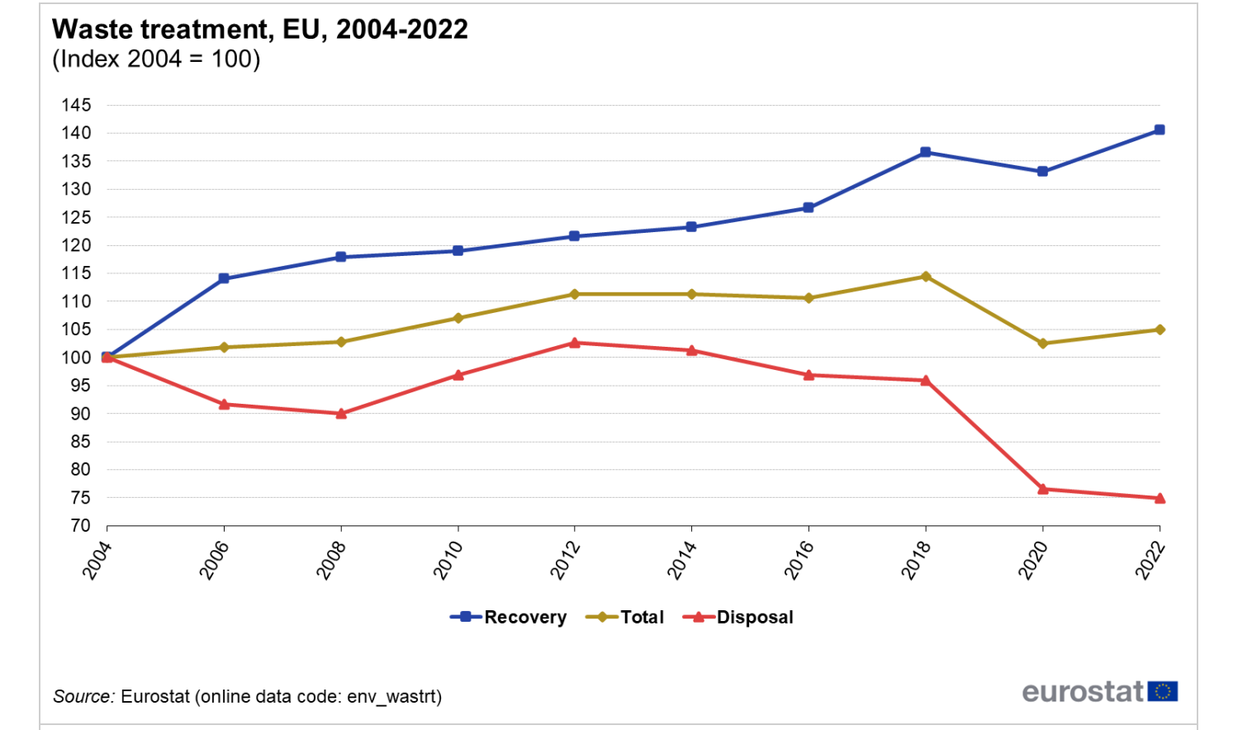

Slide 21
Transforming the economy
• Supporting research and innovation
• Environmentally harmful subsidies and well-priced Market prices are the main driver of purchasing and investment decisions, but they do not necessarily reflect the real costs of using resources and their environmental impact.
• Gradually phasing out inefficient subsidies
• Getting the price right and redirecting taxation
The market does not reflect the cost of externalities and often fails to prevent unsustainable exploitation. Market-based instruments to correct market inefficiencies (environmental taxes, fees, permit trading systems, green tax incentives). Reducing taxes on labour to stimulate employment and economic growth with “green tax reforms”, consisting of an increase in taxes on pollution or natural resources and a concomitant reduction in other taxes

Slide 22
Natural capital and ecosystem services
• Ecosystem services Our economic prosperity and well-being depend on our natural capital, including ecosystems that provide essential goods and services: fertile soils, productive seas, drinking water, clean air, pollination, flood prevention, climate regulation. For many of these services, their economic value is not accounted for in the market and, as a result, they are overused or polluted, threatening our long-term survival. 60% of the planet's ecosystem services have degraded in the last 50 years (UN data). In the EU, 88% of fish stocks are fished beyond the maximum sustainable yield and only 11% of protected ecosystems are in a positive conservation status.
• develop a map of ecosystems and their services • we need to properly value our natural capital (assess its economic value and promote the integration of these values ​​into accounting systems)
• promote the use of innovative financial instruments
• promote investments in natural capital (green infrastructure and the “restoration economy”)

Slide 23
Biodiversity
Biodiversity loss can weaken an ecosystem, compromising the provision of ecosystem services and making it more vulnerable to environmental shocks. Restoring degraded ecosystems is costly and, in some cases, changes can become irreversible.
• mainstreaming biodiversity protection into agriculture and fisheries
• achieving the targets set by the Biodiversity Strategy 2030
• Minerals and metals
• sustainable management of materials
• a “circular economy” where waste becomes a resource

Slide 24
Situation analysis and Capacity Enhancement
TECGREMED needs
The training activities help TECGREMED UNIVERSITIES to define development policy guidelines that outline a series of steps to consider in order to strengthen the capacities needed to green development planning in individual universities.
The main keyword we have defined is "GREEN", where university budget processes and key strategies for economic sectors are able to identify key actors to be involved in decision-making processes, while simultaneously outlining possible capacity needs and suggesting how to address them.

Slide 25
Natural capital and ecosystem services
• Water
• Blueprint for Europe’s water
• More effective targets and measures for water efficiency (smart meters, mandatory requirements for water-using devices, guidelines for water reuse, limitation of losses in water infrastructure, water saving in irrigation, etc.)
• Better management of demand through economic instruments (pricing, water allocation) and use of labelling and certification systems measuring the life cycle impact and virtual water content of products
• Air
• Thoroughly review EU air pollution strategies
• Accelerate the implementation of EU air quality legislation
Examples 40% of water could be saved in the EU through efficiency improvements: production, distribution, use and consumption behaviour

Slide 26
Natural capital and ecosystem services
• Land and soil Every year in the EU, over 1 000 km² of new land is used for housing, industry, roads or recreation, and around half of this land is effectively ‘sealed’. In total, an area equivalent to the island of Cyprus is built on every ten years.
• EU Commission Communication on land use • address indirect land use change • publish best practice guidelines to limit, contain or compensate for soil sealing
• establish an inventory of contaminated sites and plan restoration activities • Marine resources
• reform the Common Fisheries Policy for the sustainable management of fisheries resources • phase out environmentally harmful fisheries subsidies
• Communication on Adapting to climate change in coastal and maritime regions
• promote the sustainable use of marine resources (‘Blue Growth’)

Slide 27
Key Sectors
In industrialized countries, food, housing and mobility are responsible for 70-80% of all environmental impacts.
BUILDINGS
MOBILITY FOOD
WATER
CLEAN AIR
Key Resources
LAND & SOIL
MATERIALS MARINE

Slide 28
Key areas
• Tackling the food challenge The EU food and drink value chain is responsible for 17% of direct greenhouse gas emissions and 28% of natural resource use; our consumption habits have global impacts, especially the consumption of animal protein, which uses a huge amount of good quality water to produce. However, in the EU alone, we waste 90 million tonnes of food every year, or 180 kg per person. Most of this is food that is still fit for human consumption.
• limit waste in the food supply chain as much as possible
• assess how to reduce the environmental impact of food production and consumption patterns
• develop a sustainability-based methodology for key food commodities
• look further into security of supply and sustainable management of phosphorus
Examples 30% of food in the EU becomes waste Food Waste Bio-plastic Compost

Slide 29
Key areas
• Improving buildings Improving the construction and use of buildings in the EU would impact 42% of final energy consumption, around 35% of our greenhouse gas emissions and over 50% of extracted materials; it would also save up to 30% of water.
• Stimulate demand and uptake of efficient construction practices taking into account life-cycle costs • Incentives for resource-efficient buildings
• Ensure efficient mobility
• Internalise external transport costs

Slide 30
Management and control
• New lines of action on resource efficiency • Strengthen dialogue with stakeholders (public and private) • Invest in the transition • Define potential indicators and targets
• Support resource efficiency at international level
• Rio+20 Summit in 2012 towards a green economy and a more efficient use of natural resources
• Improve dialogue with strategic partners
• Enhance the benefits achieved through EU environmental measures Failure to implement existing environmental legislation costs around €50 billion per year.
• Measures to improve the enforcement of environmental legislation across the EU.

Slide 31
These policy guidelines that we are preparing are intended to support partner universities in their efforts to undertake a path of developing educational processes that take into account the ecological aspect, but not only.
It is therefore intended that partner universities for the purpose of a concrete development of development cooperation aimed at the environment, supporting their efforts to support this process that must necessarily start from an analysis of the labor market and its needs, in the interaction between the Labour Market and the «University World».

Slide 32
More information
A resource efficient Europe
https://environment.ec.europa.eu/index_en
European Commission-DG Ambiente:
https://climate-adapt.eea.europa.eu/it/metadata/organisations/european-commission-directorate-general-for-the-environment
Environmental legislation of UE
https://eur-lex.europa.eu/legal-content/EN/TXT/?uri=LEGISSUM%3Aenvironment

