Slide 1
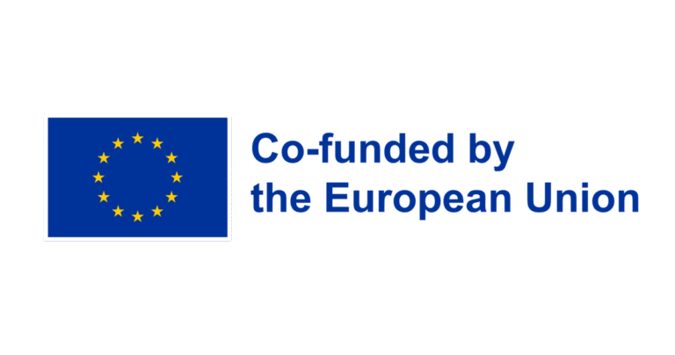
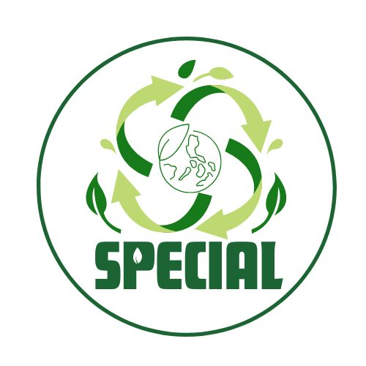
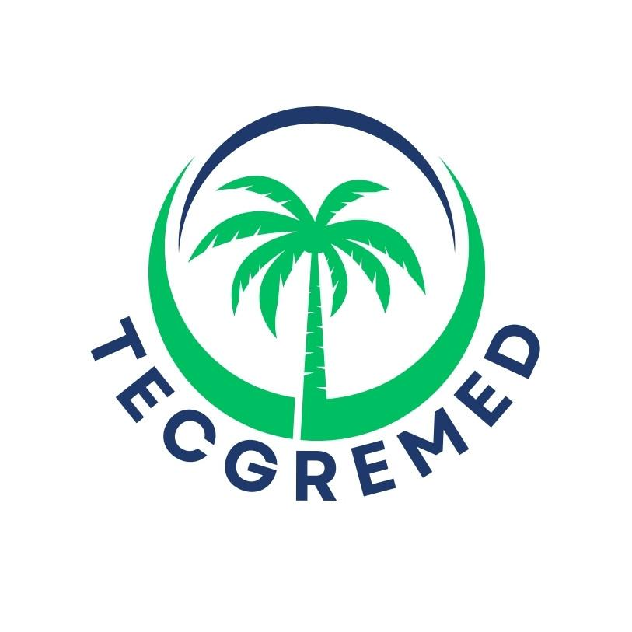
European Union Environment governance and sustainability
Prof. Alessandro Figus PhD
University of Cassino and Southern Lazio

Slide 2
UN and EU, envinronmental sustainability
On September 25, 2015, the United Nations General Assembly formally adopted the universal, integrated, and transformative 2030 Agenda for Sustainable Development. According to this document, 17 Sustainable Development Goals (SDGs) should be achieved by 2030 to promote an effective transition to a sustainable society and a resource-efficient economy.
Each SDG has specific targets that identify the type and scope of interventions needed to meet the sustainability requirements established by the 2030 Agenda. The term "sustainable development" entered into specialized language, first
then into common parlance after the 1980s, after it was officially adopted
by the UN in the report "Our Common Future," drafted by the UNEP (United Nations Environmental Program) Commission on Environment and Development.
The European Union recently accepted the SDGs and committed to integrating them into its internal and external policies.

Slide 3


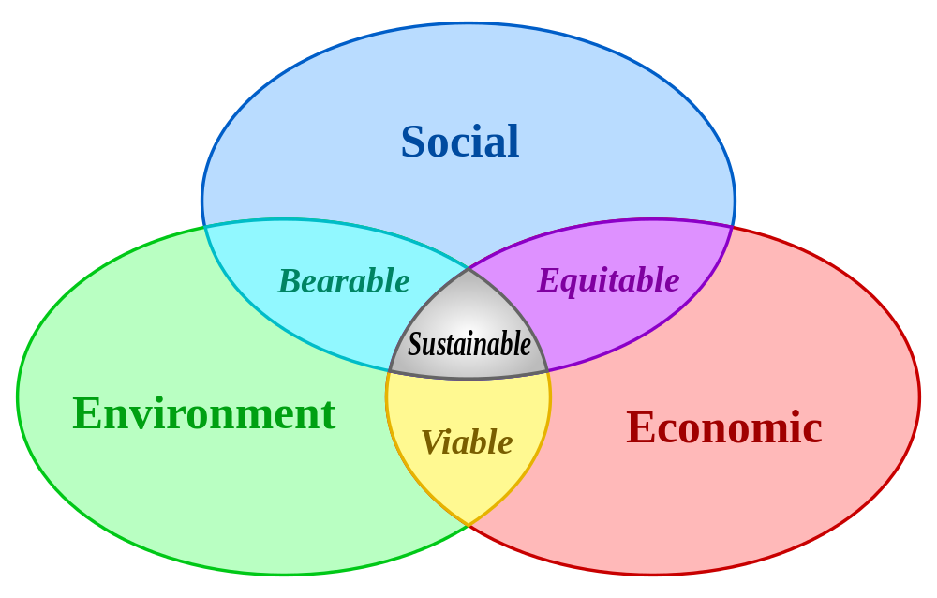

z
The SDGs were developed to be interconnected, in order to balance all three dimensions of sustainable development:
Social: e.g., quality of life, education, equal opportunities.
Economic: e.g., cost reduction, economic growth, R&D of new technologies.
Environmental: e.g., sustainable use of natural resources, pollution prevention.

Slide 4
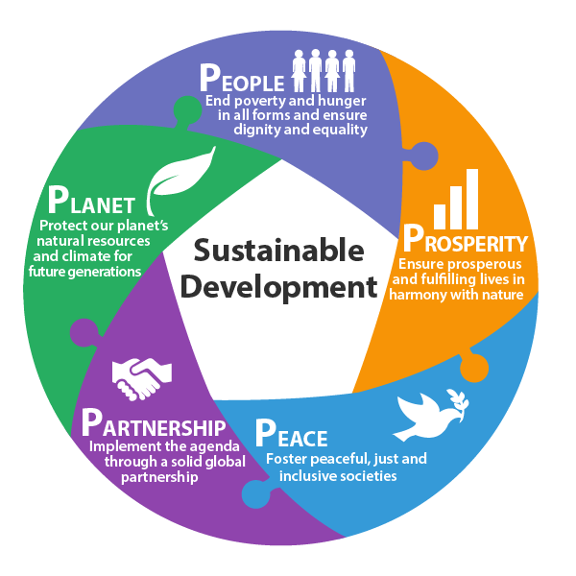
By interconnecting these three areas of interest, we define the sectors dedicated to designing approaches aimed at achieving sustainable development.
Eco-innovation, green technologies, and efficient energy use are identified by overlapping the economic and environmental fields, thus defining viable approaches.
Sustainable management of natural resources, best practices, and environmental policies are identified by overlapping the environmental and social fields, thus defining tolerable approaches.
z

Slide 5
The definition of sustainable development was introduced in the Environment Commission report (the so-called Bruntland Report),
as:
«that form of development that meets the needs of current generations without compromising the ability of future generations to meet their needs. This concept involves a balance between ecological, economic, and social factors»

Slide 6





Which resources are under the greatest anthropogenic pressure?
Land resources:
• Agricultural land Pressure from
• Forestry land
• Water surface area
Natural resources:
• Raw materials
• Water
• Fossil fuels (oil, gas, coal, uranium,
etc.)
1. Urbanization
2. Industrial pressure

Slide 7
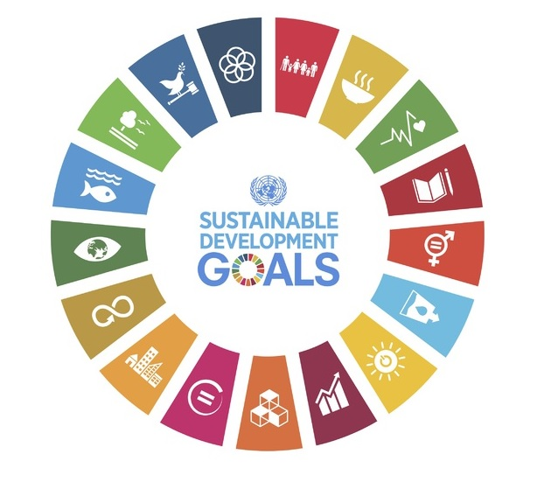
z
Environmental sustainability can only be achieved through an integrated strategy that also takes into account economic and social factors.
The SDGs that best represent environmental aspects will therefore be presented in this module, correlating them with the economic and social factors that can define viable and tolerable approaches.

Slide 8
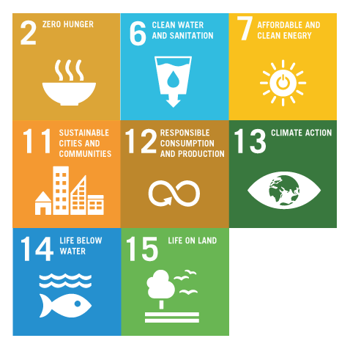
z
The following eight SDGs can be considered the most relevant for environmental sustainability:
SDG 2: End hunger.
SDG 6: Ensure affordable and sustainable water.
SDG 7: Ensure access to affordable and sustainable energy for all.
SDG 11: Make human settlements inclusive, safe and sustainable.
SDG 12: Ensure sustainable consumption and production patterns.
SDG 13: Combat climate change.
SDG 14: Conserve marine environments.
SDG 15: Conserve terrestrial ecosystems.

Slide 9


Slide 10
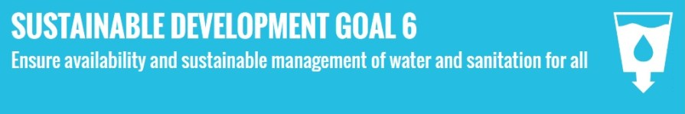

Slide 11
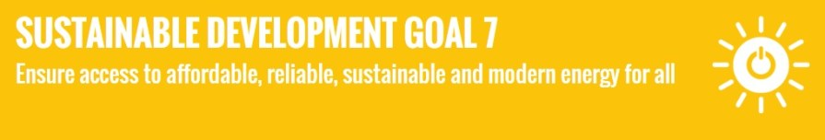

Slide 12


Slide 13
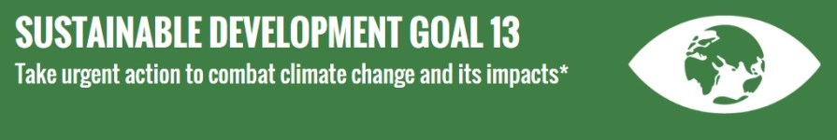

Slide 14


Slide 15
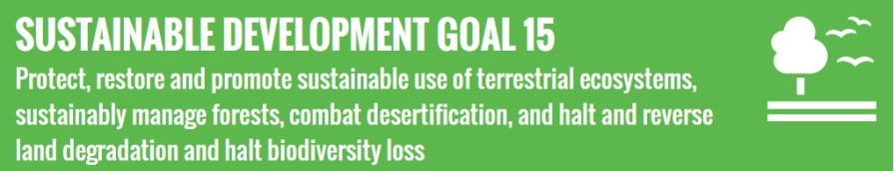

Slide 16
The Legal Order of the European Union
The European Union (EU) possesses its own legal personality, establishing a unique legal order distinct from international law. This system has a direct or indirect effect on the laws of Member States, becoming an integral part of their national legal systems.
Hierarchy of EU Law Sources
The legal structure is organized into a specific hierarchy to ensure consistency and the rule of law:
Primary Legislation (The Foundation):
  Treaty on European Union (TEU) and
  Treaty on the Functioning of the European Union (TFEU), including their protocols.

Slide 17
Introduction
    The European Union has implemented a comprehensive framework of policies to address environmental and climate change issues, including law system.
    The EU's legal basis for environmental action is established in treaties.
    In July 2021, the European climate law – a key element of the European Green Deal – entered into force, one month after the Council had adopted it. EU countries are now legally obliged to reach both the 2030 and 2050 climate goals.
    The climate law sets the framework for action to be taken by the EU and the member states to progressively reduce emissions and ultimately reach climate neutrality in the EU by 2050.
    Also in June 2021, the Council approved conclusions endorsing the new EU strategy on adaptation to climate change presented by the European Commission.
    'Fit for 55' package: A set of proposals for revision of existing legislation and new initiatives, it is the EU's key plan for turning climate goals into EU law. The package includes rules on: Energy, transport, emissions trading and reductions & land use and forestry

Slide 18
EU LEGAL ORDER
Institutions | Description
European Commission
European Parliament
Council of the European Union
European Court of Justice
European Environment Agency | The European Environment Agency provides scientific and technical expertise to support the development and implementation of environmental and climate change policies in the EU.
EU Environmental and Climate Change Regulations
The European Commission is the executive body of the EU and is responsible for proposing and implementing environmental and climate change policies and regulations.
The European Parliament is the directly elected legislative body of the EU and plays a crucial role in shaping and approving environmental and climate change legislation.
The Council of the European Union represents the member states and works together with the European Parliament to adopt and implement environmental and climate change laws.
The European Court of Justice is the highest court in the EU and ensures the consistent interpretation and application of environmental and climate change laws across member states.
The EU has enacted numerous regulations to address environmental and climate change issues, including the Renewable Energy Directive, the Emissions Trading System, and the Water Framework Directive.

Slide 19
COMPETENCE SCHEME
Division of Powers
In the EU, environmental and climate change law is governed by a competence scheme that involves the division of powers between the EU and its member states. The EU has exclusive competence in certain areas, such as setting emission reduction targets and regulating the internal market for environmental goods and services. Member states retain shared competence in other areas, such as land-use planning and environmental impact assessments. This division of powers ensures a coordinated approach to environmental protection and climate change mitigation across the EU while allowing member states to address specific local concerns.

