Slide 1


TEChnical GREen Engineering skills for MEDiterranean Region - TECGREMED
Amman ,29th June 2026
“GREEN, EU policy and BEYOND”

Slide 2
Introduction to Global Greenhouse Gas Emissions and global mean annual temperature anomalies
Anthropogenic greenhouse gas emissions, led by carbon dioxide CO2, are the fundamental drivers of rising global average temperatures. Earth’s history confirms that atmospheric greenhouse gas concentrations directly dictate global temperature trends.
The table below illustrates the global mean annual temperature anomalies

Slide 3
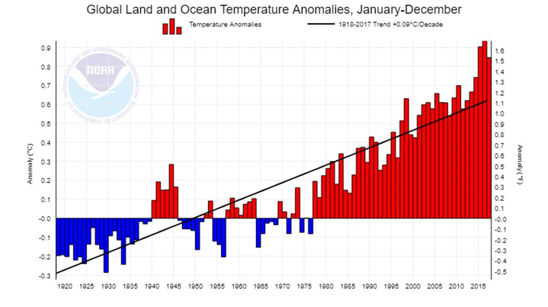

Slide 5
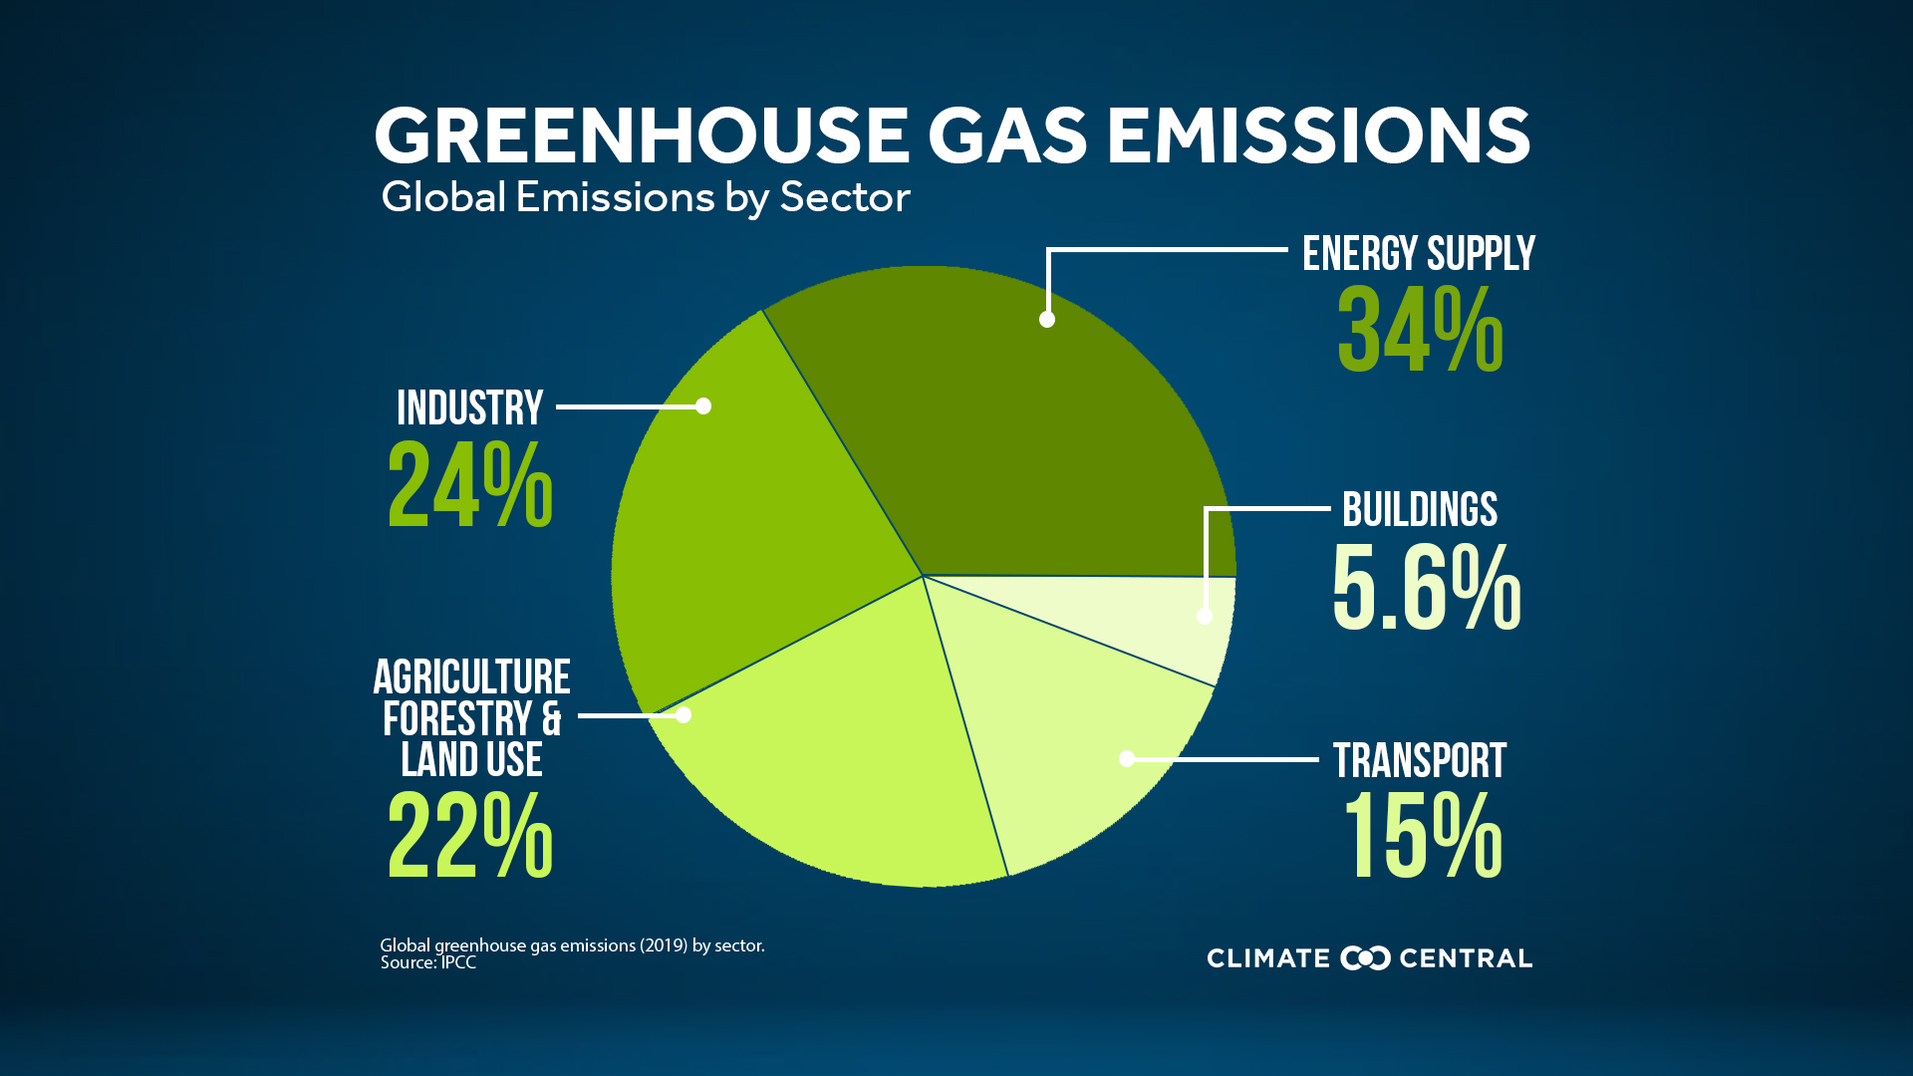

Slide 6
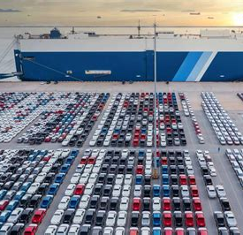
Example, the Shipping Paradox: Cargo vs. Cars
Carbon Efficiency vs. Local Air Pollution: Maritime transport emits up to 10x less CO2 per ton of cargo than road transport, yet it relies on heavy fuels that cause severe air pollution.
The Cruise Ship Impact: Just 1 large cruise ship emits as many fine particles in a single day as 1 million cars, while the European cruise fleet generates 4x more sulfur oxides than all 253 million cars in the EU combined.

Slide 7
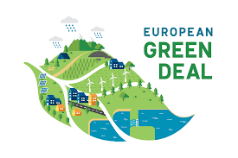
The Current Reality and
the European Response
Despite the gravity of this situation, global action has long been insufficient, presenting a deeply concerning reality. However, recognizing the lack of meaningful global progress, the European Union has taken a leading role in addressing this crisis. The EU has actively initiated comprehensive environmental policies and regulations to combat pollution and accelerate the transition toward sustainability.

Slide 8
Protection of the environment and European policy
🇪🇺 European Union Environmental Policy: Objectives & Principles
🎯 Core Objectives
The environmental policy of the European Union is dedicated to achieving the following key objectives:
Environmental Protection: Safeguarding, protecting, and continuously improving the quality of the environment.
Public Health: Ensuring the comprehensive protection of human health.
Resource Management: Promoting the prudent, efficient, and rational use of natural resources.
Global Action: Fostering international measures to address regional and global environmental challenges, with a primary focus on combating climate change.

Slide 9
Environment Action Programme
Key Action Areas of EU Environmental Policy
The policy focuses on four priority sectors:
Climate Change: Mitigating global warming and emissions.
Biodiversity: Protecting nature and ecosystems.
Public Health: Improving environment-related quality of life.
Resource Management: Optimizing natural resources and waste reduction.
These are supported by two horizontal strategies:
Global Cooperation: Enhancing international partnerships.
Strategic Policy Approaches: Improving market cooperation and implementation.

Slide 10
European Action Programme
The 8th EAP entered into force on 2 May 2022, as the EU’s legally agreed common agenda for environment policy until 2030.
The action programme reiterates the EU’s long-term vision to 2050 of living well and within planetary boundaries. It sets out priority objectives for 2030 and the conditions needed to achieve these. Building on the European Green Deal, the action programme aims to speed up the transition to a climate-neutral, resource-efficient economy, recognising that human wellbeing and prosperity depend on healthy ecosystems.

Slide 11
The 8th Environmental Action Programme (EAP)
Framework & Timeline
Effective Date: Entered into force on May 2, 2022.
Duration: Serves as the EU's common environmental agenda until 2030.
Legal Status: Formally and legally agreed upon by all EU member states.
Long-Term Vision & Goals
2050 Vision: Achieve the goal of "Living well, within planetary boundaries."
Strategic Foundation: Built directly upon the European Green Deal.
.

Slide 12
Key Targets:
  Accelerate the transition to a climate-neutral economy.
  Develop a highly resource-efficient system.
  Safeguard healthy ecosystems to ensure human well-being and prosperity.

Slide 13
The program developed in previous years
Future Outlook ( to 2030)
Strategic Integration: Environmental policy remains a core pillar of the Europe 2020-2030 Strategy.
Ambitious Goals: Continuous commitment to high climate and environmental targets.
Adaptive Approach: The EU Commission actively adapts new programmes to a rapidly changing global environment.

Slide 14
Economic Impacts & Market Standards
Fair Internal Market
Harmonized Standards: Common EU environmental rules ensure level playing fields.
Anti-Protectionism: Prevents unfair eco-protectionism between member states.
No Eco-Dumping: Eliminates cost-cutting at the expense of the environment.
Transport & Traffic Costs
Economic Burden: Environmental costs of transport equal 5% of EU GDP.
Infrastructure Strain: High fiscal impact from pollution and traffic congestion.
Public Health Costs
Financial Toll: Air pollution costs Europe €50 to €100 billion annually.
Social Impact: Accounts for 350,000 premature deaths per year.
Labor Loss: Results in 150 million lost working days every year.

Slide 15
Cost of inaction: “The benefits of strong and timely action far outweigh the economic costs of inaction” (Stern Report, 2023):
• Action => 1% of global GDP per year until 2050 • Inaction => up to 20% of global GDP per year • Multi-annual project TEEB – The Economics of Ecosystems and Biodiversity (EC+G8+UNEP): analyzed the economic value of ecosystems and biodiversity: the benefits of investing in ecosystem protection exceed the costs by a factor of between 3 and 75.
• “In recent years, financial crises have periodically recurred, costing Wall Street around $1,000-$1,500 billion each time they have occurred. In fact, every year we lose natural capital worth between $2-$5,000 billion."

Slide 16
Competition for natural resources
Global population and living standards expanding on an unprecedented scale (9 billion in 2050):
2 billion people with 'middle class' consumption levels in today's developing countries will triple their consumption by 2020.
Demand for food, feed and fibre could increase by 70% by 2050, global demand for energy and water by 40% as early as 2030. 2050: 9 billion 2011: 7 billion

Slide 17
Resource efficiency
Global Resource Crisis: Rapidly rising demand triggers critical raw material shortages and severe ecosystem depletion.
High EU Consumption: EU citizens consume 16 tonnes of materials per capita annually, driven heavily by imports.
Import Footprint: Over 20% of EU resources are imported, carrying a hidden footprint 3 to 6 times their physical mass.
Geopolitical Competition: Countries like China secure scarce global assets (mines, land) via aggressive "land grabbing."
Climate Pressure: Climate impacts, such as Mediterranean droughts, further accelerate global resource scarcity.

Slide 18
Transforming the economy
Supply-Side Actions (Production & Design)
Efficient Production: Incentivizing eco-efficient manufacturing processes.
Ecodesign Expansion: Extending Ecodesign directives to non-energy-related products.
Extended Producer Responsibility (EPR): Covering the full life cycle (take-back, recycling, repair).

Slide 19
Transforming the economy
Turning Waste into a Resource
The Challenge: The EU generates 2.7 billion tonnes of waste annually (98M tonnes hazardous), but only 40% is recycled, with the rest landfill-bound or incinerated.
The Strategy: Maximize circularity by establishing binding targets, minimum recycled content quotas, and strict durability criteria, while cutting illegal hazardous waste shipments and aligning EU public funds with highest-level recycling priorities.

Slide 20
Waste Management: Prevention & Hierarchy
The Waste Hierarchy: Prioritizing management steps from most to least sustainable: Prevention \(\rightarrow \) Reuse \(\rightarrow \) Recycling \(\rightarrow \) Recovery \(\rightarrow \) Disposal.
Strategic Shift : Moving up the hierarchy by strictly focusing on the top three tiers:
  Prioritize Prevention (Avoid generating waste)
  Maximize Reuse (Extend product lifespans)
  Optimize Recycling (Recover valuable materials)

Slide 21
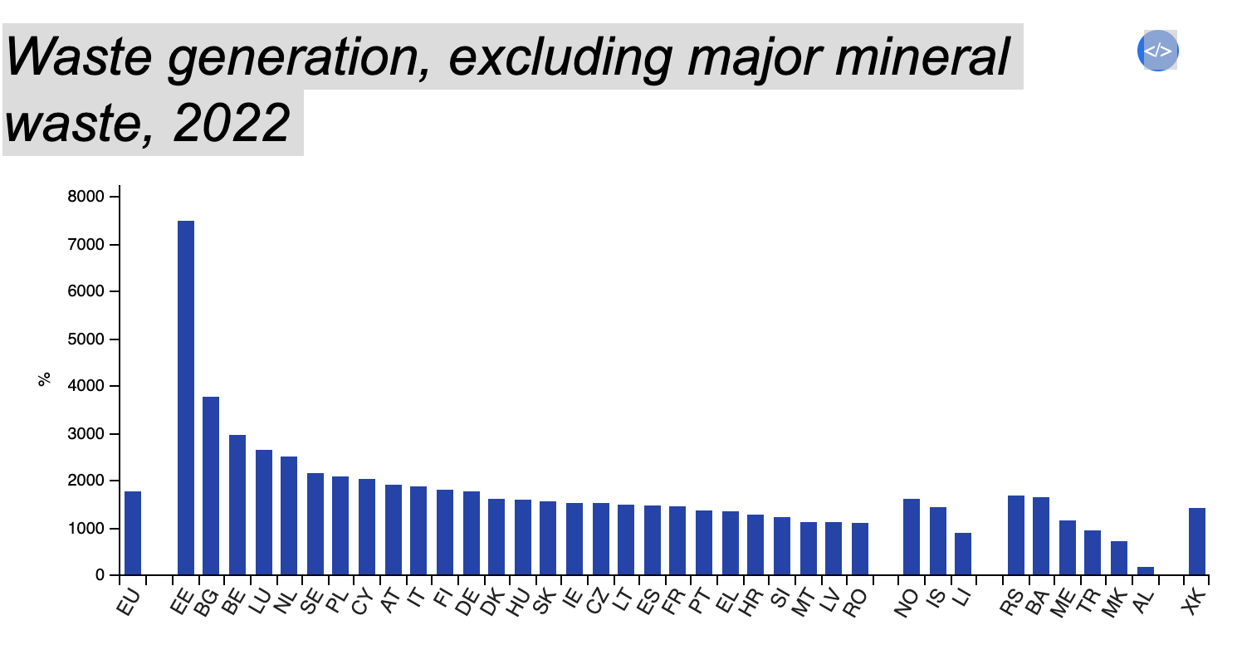
Highlights
In 2022, 5.0 tonnes of waste were generated per EU inhabitant.
In 2022, 40.8% of waste were recycled and 30.2% landfilled in the EU.

Slide 22
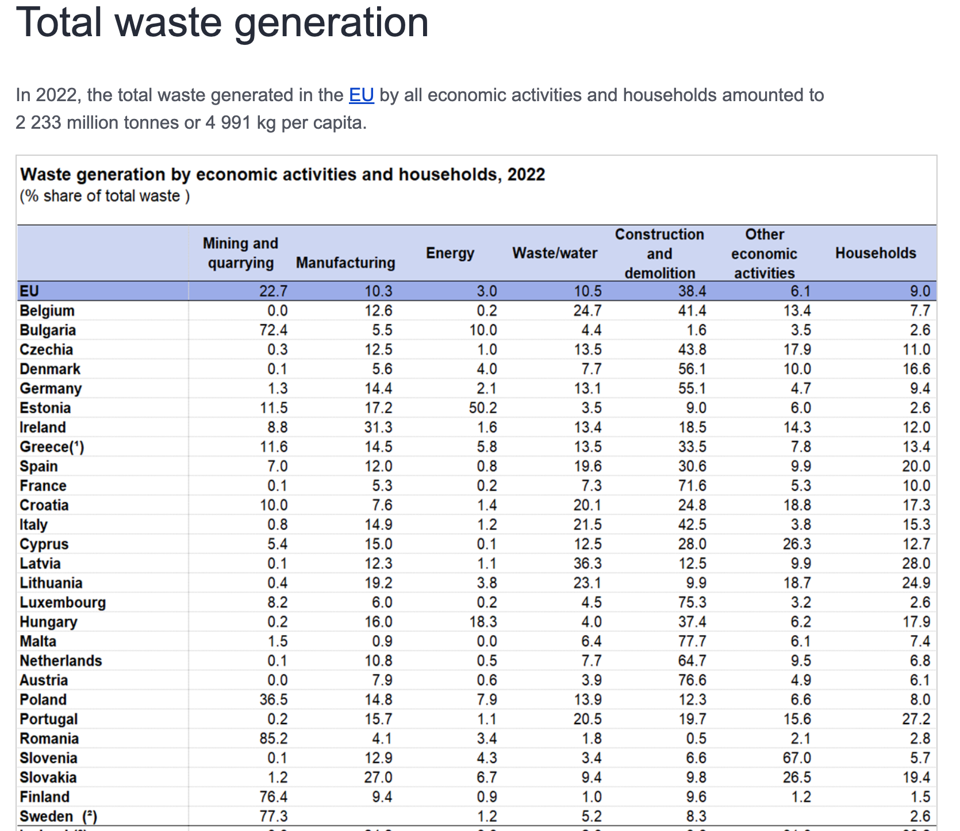

Slide 23
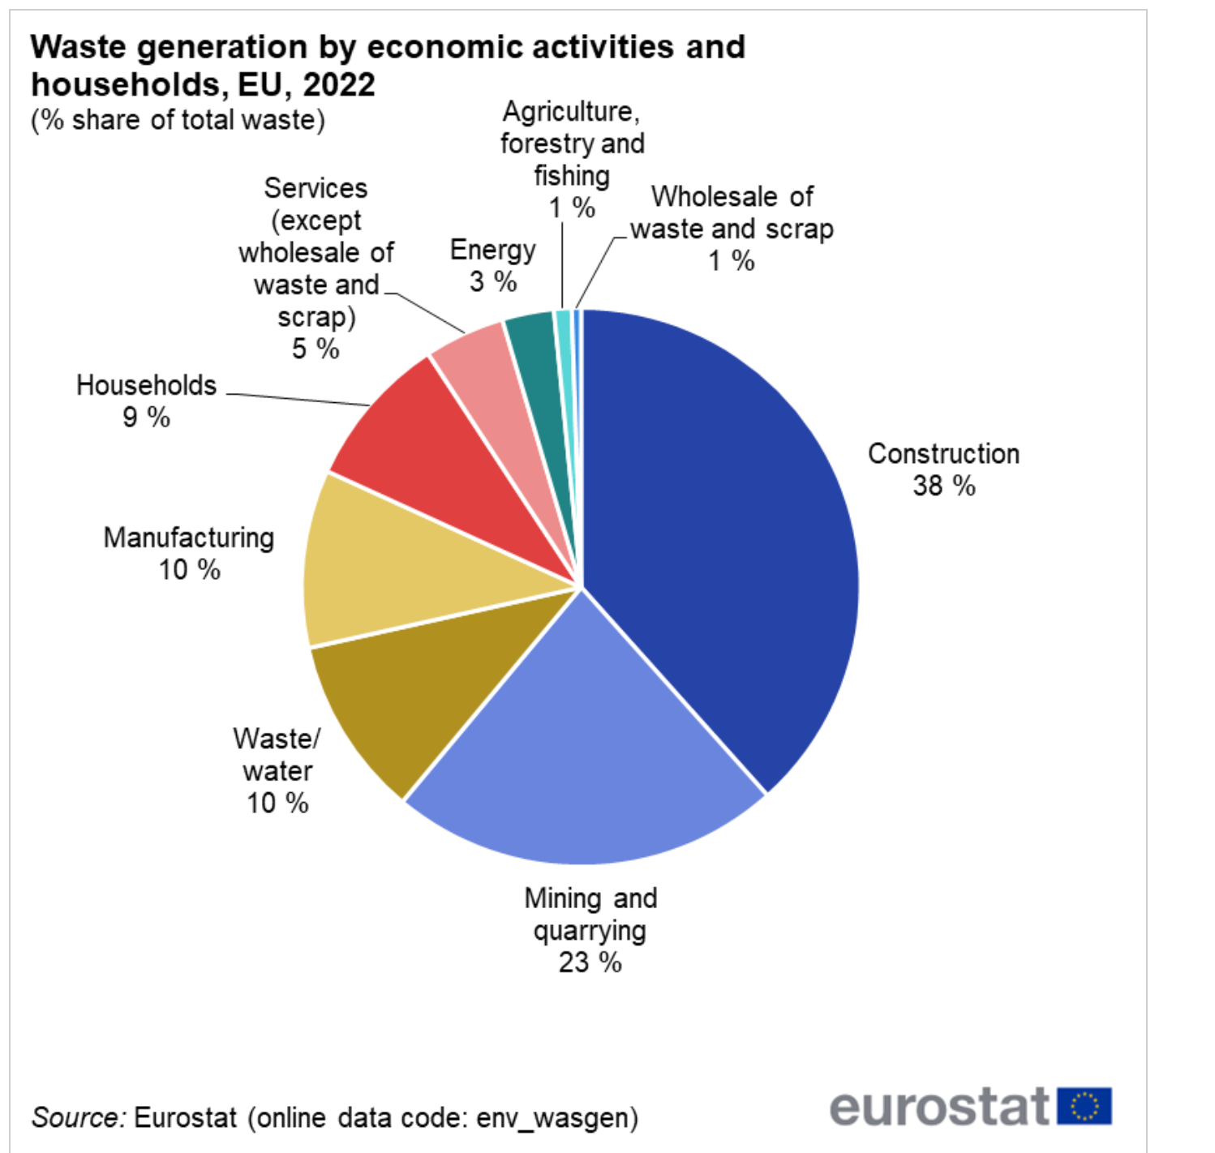

Slide 24
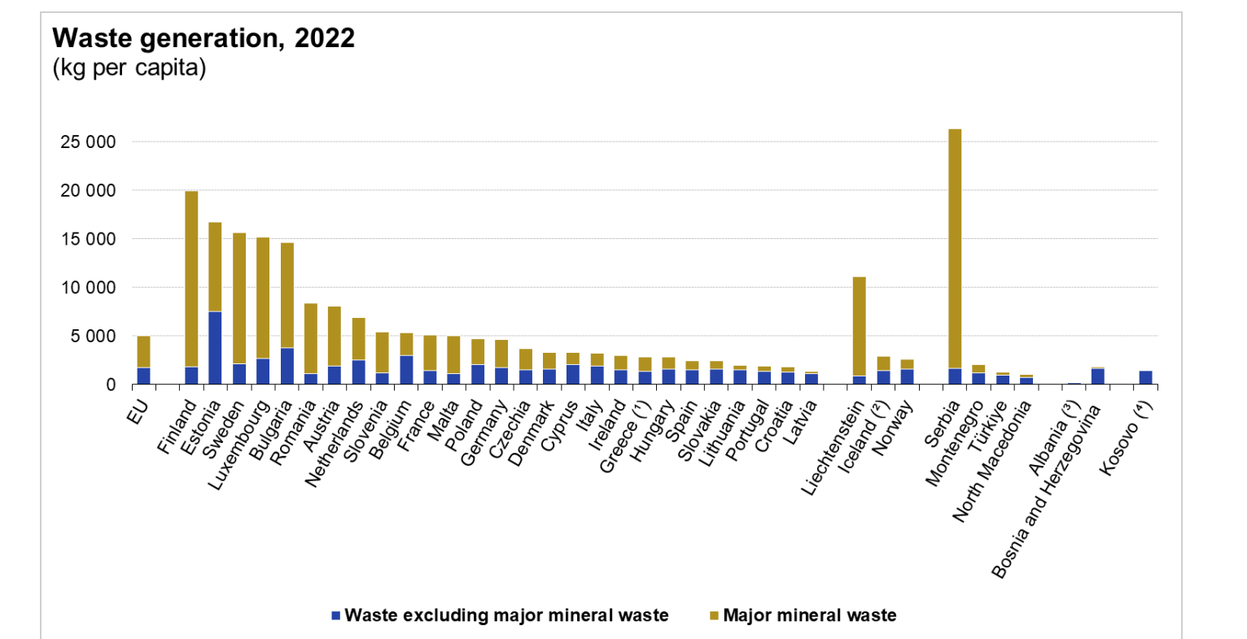

Slide 25
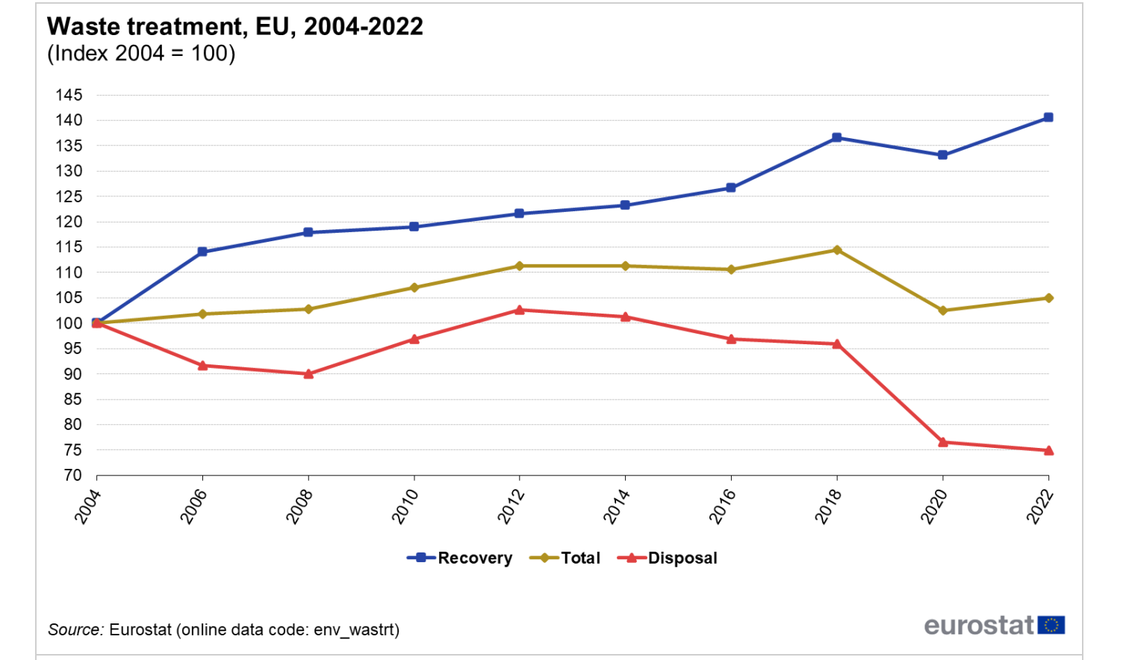

Slide 26
What the EU is doing: Frameworks & Actions
The European Union actively enforces the waste hierarchy through concrete legislative frameworks, funding, and circular economy strategies:
The Circular Economy Action Plan (CEAP): A core pillar of the European Green Deal that introduces legally binding targets to reduce waste generation and double the EU's circular material use rate by 2030.
The Ecodesign for Sustainable Products Regulation (ESPR): EU rules that force manufacturers to design products that are easier to repair, reuse, and recycle, tackling waste at the source (Prevention).
"Right to Repair" Legislation: A recent directive that empowers consumers by making repairs more accessible and affordable, directly promoting Reuse over disposal.
Strict Recycling Targets: EU directives mandate that member states recycle at least 55% of municipal waste by 2025, rising to 65% by 2035, while limiting landfilling to a maximum of 10%.
Financial Incentives (Cohesion Funds): The EU blocks public funding for new landfills or incinerators, redirecting billions of euros exclusively toward advanced recycling and sorting infrastructure.

Slide 27
Supporting Research, Innovation & Natural Capital
Fixing Market Prices: Phasing out harmful subsidies and correcting market inefficiencies through environmental taxes and green incentives.
Green Tax Reforms: Shifting the tax burden by increasing taxes on pollution and resource use while lowering taxes on labor to boost employment.
The Value of Ecosystems: Protecting the natural capital (clean air, water, pollination) that underpins economic prosperity but lacks market valuation.
Alarming Degradation: Addressing critical data showing 60% of global ecosystems degraded, 88% of EU fish stocks overfished, and only 11% of protected habitats in good status.
Strategic Actions: Mapping ecosystems, integrating natural capital into accounting systems, and promoting innovative investments in green infrastructure.

Slide 28
Biodiversity
Biodiversity loss can weaken an ecosystem, compromising the provision of ecosystem services and making it more vulnerable to environmental shocks. Restoring degraded ecosystems is costly and, in some cases, changes can become irreversible.
• mainstreaming biodiversity protection into agriculture and fisheries
• achieving the targets set by the Biodiversity Strategy 2030
• Minerals and metals
• sustainable management of materials
• a “circular economy” where waste becomes a resource

Slide 29
Situation analysis and Capacity Enhancement
TECGREMED needs
The training activities help TECGREMED UNIVERSITIES to define development policy guidelines that outline a series of steps to consider in order to strengthen the capacities needed to green development planning in individual universities.
The main keyword we have defined is "GREEN", where university budget processes and key strategies for economic sectors are able to identify key actors to be involved in decision-making processes, while simultaneously outlining possible capacity needs and suggesting how to address them.

Slide 30
Key areas
The EU food system generates massive global impacts, accounting for 17% of greenhouse gas emissions and wasting 88 million tonnes of food annually. To address this crisis, the EU aims to minimize food supply chain waste and reduce the environmental footprint of animal protein production.
This strategy relies on introducing sustainability-based methodologies for key commodities while securing the long-term management of phosphorus.
Example: 30% of food in the EU becomes waste Food Waste Bio-plastic Compost
Optimizing EU buildings addresses 42% of energy use, 35% of greenhouse emissions, 50% of materials, and saves 30% of water.
The strategy drives this by incentivizing resource-efficient construction, ensuring efficient mobility, and internalizing transport costs.

Slide 31
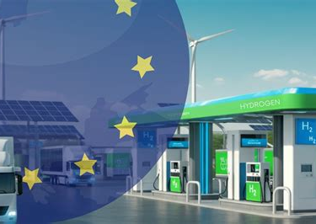
Fueling EU Policy and «Beyond»
Green as the Driver: Placing environmental sustainability at the core of every regulatory framework.
Green and EU Policy: Transforming political mandates into concrete, actionable climate neutrality targets.
Green and Beyond: Accelerating eco-innovation past basic compliance to unlock long-term regenerative value.

Slide 32
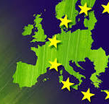
Conclusion
Guideline Purpose: These policy guidelines aim to assist partner universities in developing holistic educational processes that integrate ecological and sustainable dimensions.
Strategic Collaboration: The initiative strengthens development cooperation by aligning environmental goals with an in-depth analysis of current labor market needs.
Core Synergy: This process bridges the gap between the Labour Market and the University World, fostering a concrete, future-oriented educational ecosystem.

Slide 33
More information
A resource efficient Europe
https://environment.ec.europa.eu/index_en
European Commission-DG Ambiente:
https://climate-adapt.eea.europa.eu/it/metadata/organisations/european-commission-directorate-general-for-the-environment
Environmental legislation of UE
https://eur-lex.europa.eu/legal-content/EN/TXT/?uri=LEGISSUM%3Aenvironment

