Slide 1



PIC 911453808
ERASMUS-VET
Universities -Communities:
strengthening cooperation
KICK OFF MEETING
AMMAN 2025
PIC 911453808
Prof. Dr. Diana SPULBER
TECGREMED
FONDAZIONE SICUREZZA E LIBERTA’

Slide 2



The Foundation sicurezza e liberta’ - FSL the relationship
SIULP
IS THE LARGEST ITALIAN
POLICE TRADE UNION
FSL
SIULP is the promoter member of the FOUNDATION.
The purpose of the Foundation is to pursue goals of social solidarity and cultural promotion through study, research and training initiatives in the juridical, historical, economic and values area.

Slide 3

Fondazione sicurezza e libeRTà
represent the subjects who deal with social security;
disseminate culture and training in legality on the civil model (Italian Law 121/81 reform of the security system);
develops “educational, information and training activities”a and “research”, in pursuit of the objective of improving the level of security in general and social security in particular, and the quality of life of citizens and territories;
The operating area of Security are:
Social security (in cooperation with the Univ. partner)
Urban security and control of the territory
Work security and Job security
Ambiental security and prevention
(in cooperation with the Ambiental Police )

Slide 4
«FoUNDATION SECURITY and freedom»
promotes, develops and qualifies training on a cultural, ethical and professional level (above all) the Safety Sector;
To be a point of reference for public and private bodies, companies and citizens, through the establishment of training courses, promotion of conferences, seminars or by operating any kind of information action on issues concerning safety.
National and International perspectives

Slide 5




What we are doing?
Courses
Human Rights
Arab Course
The Human Security, Human Rights and Global Governance course provides multi - and inter-disciplinary training. It promotes the critical capacity, the analytical
approach to the proposed topics and the development of the skills necessary to carry out research. The course develops the knowledge and skills necessary to protect and promote human rights in the context of political and legal processes of multilevel governance, from the local to the national and international levels. The goal is to provide students with the skills and tools to analyze political, social and cultural phenomena and their impact on the different levels of governance.
HE Master first level

Slide 6
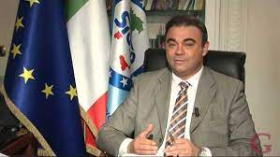
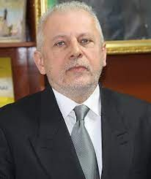
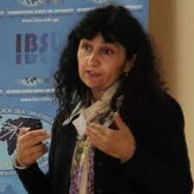
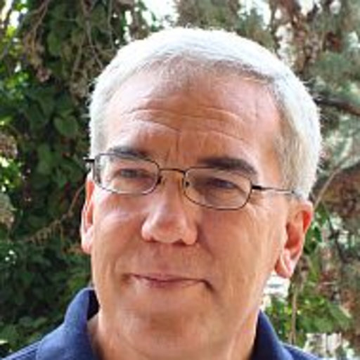
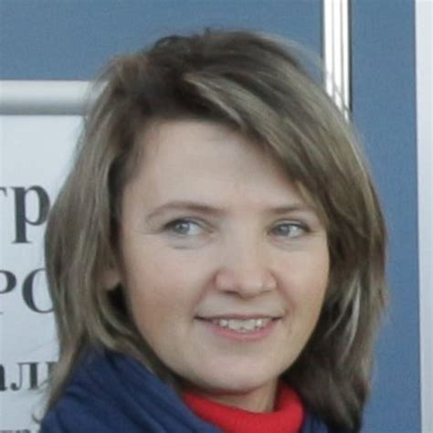
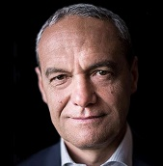
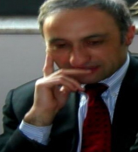
The scientific board
Dr. Felice Romano
General Secretar SIULP,
President of Fondazione Sicurezza e libertà
Prof. Dr. Alessandro Figus
University of Cassino and Southern Lazio
International Institute of Management IMI-Nova Moldova
Prof. Dr. Patrizia Gazzola
Insubria University
Prof. Dr. Guido Amoretti
University of Genova
Prof. Dr. Diana Spulber
University of Genova
Prof. Eng. Giovanni Betta
University of Cassino and Southern Lazio
Prof. Dr. Francesco Petrillo
Campobasso University

Slide 7


Erasmus+
609905-EPP-1-2019-1-EPPKA2-CBHE-JP
Development of Skills and Teachers Training for leadership
Specific Objectives:
• Defining specific competencies necessary for local community leaders and developing strategies of leadership support through networking in international, regional and local communities
• Developing interdisciplinary modularized thematic cluster for training leaders in 3-cycle system of higher education involving Bologna progress tools and mechanisms
• Modernizing and developing programs for retraining of local community leaders by integrating formal and non-formal education
• Establishing Centers for Non-formal Education for Local Community Leaders with Public E-Lab as a platform for e-networking, design, development and promotion of socially significant ideas of the local community
FINAL CONFERENCE: PETROPAVL KAZ 10-11 May 2023
www.destt.info

Slide 8
The EDUCATIONAL partnerS
International Institute of Management IMI-Nova, Moldova
University of Genova, Italy
University of Catania, Italy
University of Cassino and Southern Lazio, Italy
University Mercatorum, Italy
Lumsa University, Italy
Nebrija Universidad, Spain
University Kozybayev, Kazakhstan
Amanzholov Sarsen Ust Kamenogorsk University, Kazakhstan

Slide 9
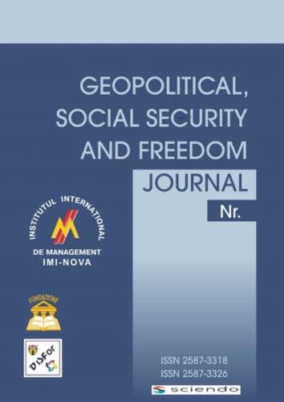
The Journal
(classified A by ANVUR field 14) partner: University of Genova (Italy), International Institute of Management (Moldova) and Foundation (IT)
Edited by SCIENDO
Https://sciendo.com/journal/GSSFJ
Journal is focus on :
critical discussion for analysis and explore themes and / or problems related to conflict resolution,
critical discussion for analysis of concept of social security,
concept of freedom,
geopolitics security,
economic security,
international cooperation.

Slide 10
Doctoral studies PHD
Doctoral Course in Educational Models and Contexts:
Sport, Inclusion and Technologies
In partnership with the University of Cassino and Southern Lazio
The course aims to train highly qualified professional figures who are able to design and apply innovative research programs and socio-educational services in public and private entities, encouraging the development of knowledge and skills in the field of research in health education and promotion in a transdisciplinary perspective.

Slide 11
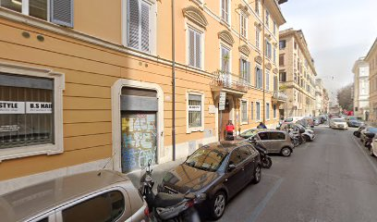
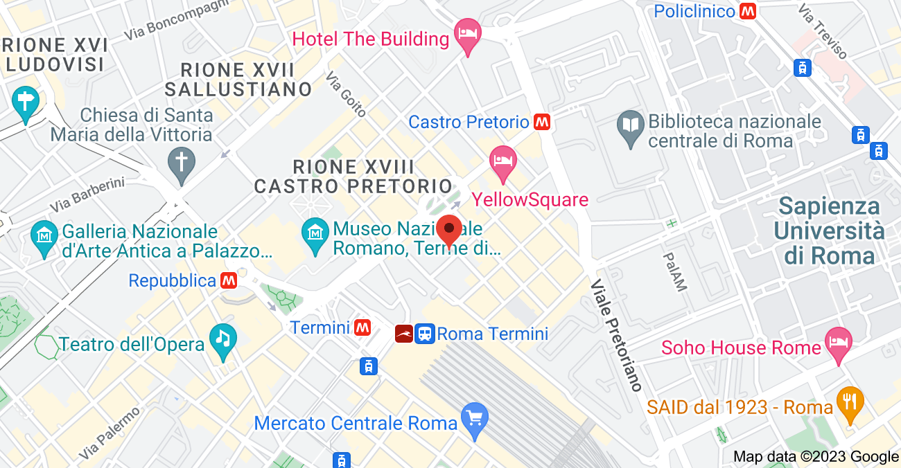
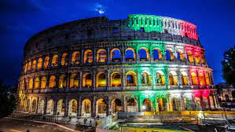
Fondazione sicurezza e libertà
Where we are?
VIA VICENZA 26 ROMA ITALY

Slide 12
Thank you for YOUR ATTENTION
☺☺☺

