Slide 1


Overview of TECGREMED Project
Insert Erasus+ Logo Here
Erasmus+ CBHE VET Project
—TECGREMED Stakeholders Meeting (Zarqa )
16 Oct 2025
Notes:
Replace the two placeholder boxes with the Erasmus+ and TECGREMED logos.
Suggested brand colors: deep blue for Erasmus+, green accent for sustainability theme.

Slide 2
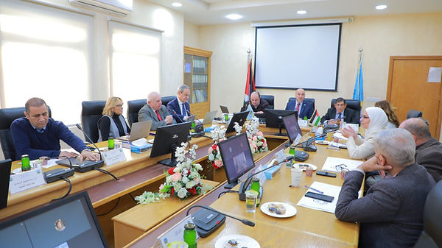
TECGREMED KICK OFF MEETING
Amman 12-14 January 2025

Slide 3
Why TECGREMED?
Tackle youth skills–jobs mismatch in MENA; inclusion of refugee and local youth.
Aligns with EU policy context and UN SDGs (Decent Work, Reduced Inequalities).
Green & Sustainable Focus
Integrates sustainability and green practices across training and outputs.
Supports SDGs on clean energy, innovation, circularity, and climate action.
Notes:
Frame the socio-economic challenge and the policy context. Emphasize barriers for refugee youth and the need for market-relevant skills.

Slide 4
TECGREMED Objectives
Bridge the skills gap with training tied to real labor-market needs.
Improve employability and inclusion for youth in the region.
Strengthen university–industry links around green and digital transitions.
Notes:
Keep objectives concise; link to measurable training participation and employability outcomes.

Slide 5
Anticipated Impact
Better job readiness for youth, including refugees.
Stronger university–industry bridges in green/digital transitions.
Regional cooperation supporting inclusive growth and SDGs.
Create Green learning Laboratory
Create 4-5 training modules
Notes:
Connect impact to SDGs and EU/MENA policy objectives.

Slide 6
Project Overview
TECGREMED = Technical Green Engineering skills for Mediterranean Region (Erasmus+).
Purpose: close skills–jobs gaps and improve employability of youth (incl. refugees) via VET-focused, market‑aligned training.
Scope: Jordan, Palestine, Morocco with EU partners; integrates green practices and sustainability.
Notes:
Concise overview derived from the uploaded Work Plan.

Slide 7
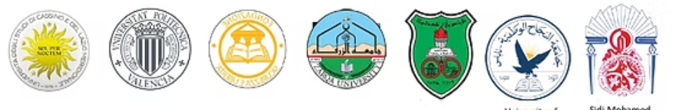
Consortium (Europe–MENA)
University of Cassino and Southern Lazio (Coordinator, Italy)
Polytechnic University of Valencia (Spain); Fondazione Sicurezza e Libertà (Italy)
Zarqa University; University of Jordan (Jordan)
An‑Najah National University (Palestine); Sidi Mohamed Ben Abdellah University (Morocco)
Notes:
Briefly introduce roles; highlight the balanced Europe–MENA partnership.

Slide 8
Project Phases
Phase 1 – Management & Coordination (M1–M24): agreements, committees, daily coordination, steering meetings.
Phase 2 – Preparation & Capacity Enhancement (M1–M10): kick‑off; baseline data; create Green Practices Workspace; choose study levels; recruit LM partners; train curriculum developers.
Phase 3 – Curriculum Development & Implementation (Y2 ≈ M9–M22): framework & templates; course (re)design; train academic/VET staff; review & EU benchmarking; approval/accreditation; 1‑year course implementation & work placements.
Phase 4 – Exploitation, Quality & Dissemination (M1–M24): quality & dissemination plans, formative evaluation, three training workshops in vocational institutions (North Morocco / Jordan / Palestine).

Slide 9
Expected Outputs
Signed partnership agreements, established governance bodies, and coordinated management artifacts.
Baseline dataset on curricula gaps, market needs, and stakeholder profiles; operational Green Practices Workspace.
Curriculum framework/templates and (re)designed VET courses aligned to employer needs; EU‑benchmarked & accredited.
Trained academic and VET staff in EU/Jordan; implemented courses for a full cycle with student projects and placements.
Quality and dissemination plans; monitoring and formative evaluation reports; 3 training workshops in partner VET schools.
Notes:
Summarizes tangible deliverables and outcomes expected from the plan.

Slide 10
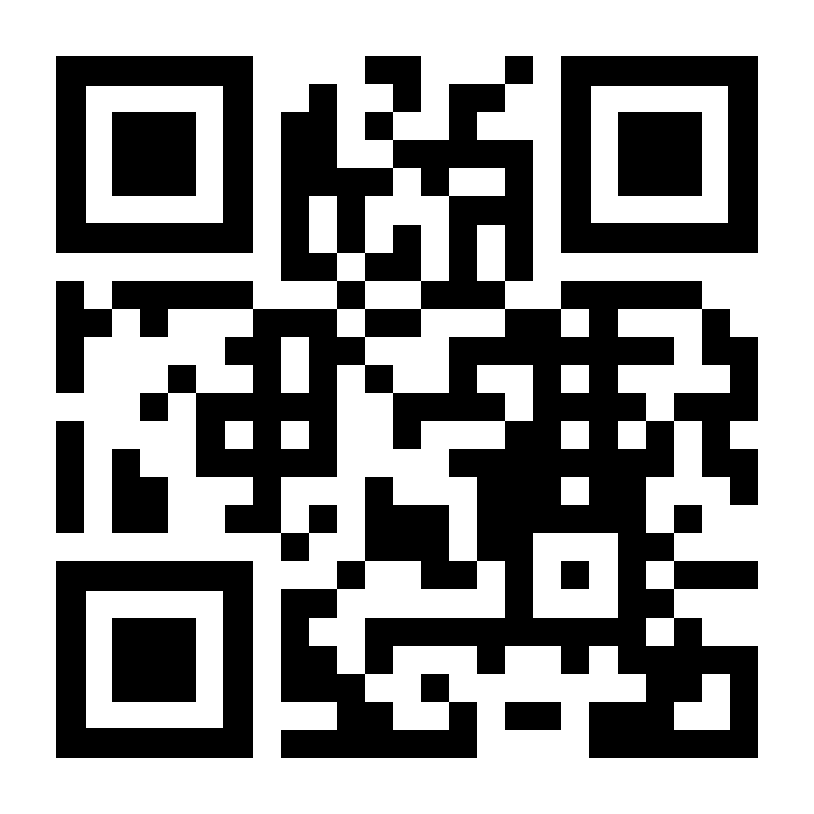
Contacts & Next Steps
Coordinator: University of Cassino and Southern Lazio.
Local Coordinator : Email: ashaqadan@zu.edu.jo
Follow website News/Plans for updated materials and events.
https://www.tecgremed.com/
Notes:
Invite stakeholders to engage and monitor updates.

